Slide 1
Mindmap
James’ school payment plan
Notes:
Add your team member names on the slide.

Slide 2
Step 1. Make a mindmap of how James funds his education currently. Work it out on a whiteboard and input the picture to google slide.
Notes:
Step 1. Make a mindmap of how James funds his education currently. Work it out on a whiteboard and input the picture to google slide.

Slide 3
Step 2. Create an IPO model (input, process, outputs) to explain the different revenue streams.
For example, (input) James works as a bartender --> (process) bar pays him and withholds federal, state, and city taxes --> (output) James pays for his schooling expenses from his paycheck.
Federal taxes are collected (input) --> (process) --> (outcomes)
State taxes are collected (input) --> (process) --> (outcomes)
City taxes are collected (input) --> (process) --> (outcomes)
State University receives _______ (input) --> (process) -->(outcomes)
And so forth and so on ...
Notes:
Step 2. Create an IPO model (input, process, outputs) to explain the different revenue streams.
For example, (input) James works as a bartender --> (process) bar pays him and withholds federal, state, and city taxes --> (output) James pays for his schooling expenses from his paycheck.
Federal taxes are collected (input) --> (process) --> (outcomes)
State taxes are collected (input) --> (process) --> (outcomes)
City taxes are collected (input) --> (process) --> (outcomes)
State University receives _______ (input) --> (process) -->(outcomes)

Slide 4
Step 3. Imagine for a minute that James was living in 2050 and had a free education like Arnold describes in LEARN!2050.
What or who would be paying for James' education? Why would those people or organizations be paying for his education? Would James' free education really be free or would he have to pay it back by doing a certain job or working for a certain company, organization, or community or pay back loans etc? What role would AI and automation have to do with James?
Notes:
Step 3. Imagine for a minute that James was living in 2050 and had a free education like Arnold describes in LEARN!2050. What would be different if education were free. What or who would be paying for James' education? Why would those people or organizations be paying for his education? Would James' free education really be free or would he have to pay it back by doing a certain job or working for a certain company, organization, or community or pay back loans etc? What role would AI and automation have to do with James?

Slide 5
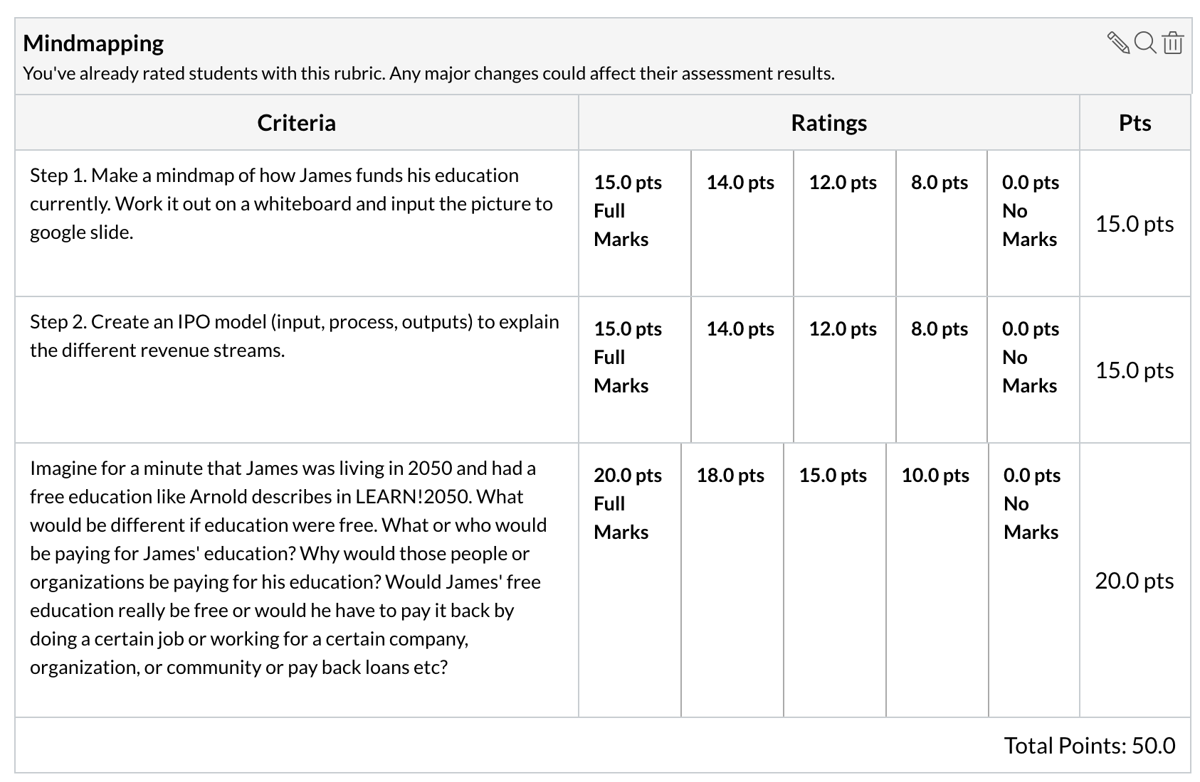
Rubric
Points: 50
Submitting: a website url

