Slide 1
Future of work and education
Please write the name of people answering the questions

Slide 2
Video 1: Anthony Goldbloom https://www.ted.com/talks/anthony_goldbloom_the_jobs_we_ll_lose_to_machines_and_the_ones_we_won_t/transcript (Links to an external site.)
Question :: What are the features of future work and how might those skills be taught in 2050?

Slide 3
Video 2: Martin Ford 14:38 minutes https://www.ted.com/talks/martin_ford_how_we_ll_earn_money_in_a_future_without_jobs (Links to an external site.)
Question :: What kind of work will people do in 2050?

Slide 4
Video 3: Bill Gates 1:40 Minutes https://qz.com/911968/bill-gates-the-robot-that-takes-your-job-should-pay-taxes/ (Links to an external site.)Links to an external site.
Question :: Who will pay for people who lost employment to robots?

Slide 5
Video 4: Andrew McAfee 14:22 Minutes https://www.ted.com/talks/andrew_mcafee_what_will_future_jobs_look_like (Links to an external site.)
Question :: What are the two challenges that we face? What kind of education will people need?

Slide 6
Video 5: Rutger Bregman 14:57 minutes https://www.ted.com/talks/rutger_bregman_poverty_isn_t_a_lack_of_character_it_s_a_lack_of_cash (Links to an external site.)Links to an external site.
Question :: What can be done to prevent poverty?

Slide 7
Reflection: How do your ideas about work relate to the future of education?
Arnold Wasserman wrote an article for the Design Management Institute (DMI) in 2014, “Learn! 2050: How we transformed America’s learning system”. See full article online here.
"Today's Generations Alpha and Beta cannot remember a time when all public education, from pre-school through college, wasn't free. They can't believe that today's public curriculum, rich not only in science, technology, engineering, and math but also the arts, design, creativity, history, language, and all the other humanities—plus exercise, sports, yoga, and meditation—was not always the norm. Were we once forced to make the binary choice—either a broad humanistic education or technical career preparation? Was there really a time when we did not apply state-of-the-art cognitive neuroscience, learning science, sociology, and electronic technology to student-centered, self-paced, creativity-based open learning?
Did students back then actually spend their entire day butts-in-a-chair at a single location? Today, learning takes place everywhere—out in the community and at cultural institutions, at fab labs, tech shops, tinker spots, arts studios, innovation hubs, and at learning incubators and accelerators. It takes place online, on-demand, and just-in-time. It is flipped, blended, and open. An American student learns in peer study groups with partners in other countries. Her e-learning coach may be anywhere in the world. Teacher-coaches are expert at knowing which students need more scaffolded structure versus self-directed messing around—and when. Today's students know that you don't learn by getting the right answer but by asking good questions and by failing early, fast, and often. Little of this was true in the early 2000s."
(a) How might the future of work you explored today relate to free education for STEM, humanities, arts, health and wellness, yoga, exercise, etc in 2050?

Slide 8
Optional Clip:: David Autor
18:38 minutes https://www.ted.com/talks/david_autor_why_are_there_still_so_many_jobs
Are jobs really going away and not coming back?

Slide 9
Step 1 :: Last week you explored the skills necessary in the future.
Write the main points below for your teams one minute report back to the class
Notes:
Last week you imagined the skills that are necessary for the future of work based on some video clips that describe AI and machine learning predictions. Please write what some of the key features of skills necessary for the future of education according to your teams discussion.

Slide 10
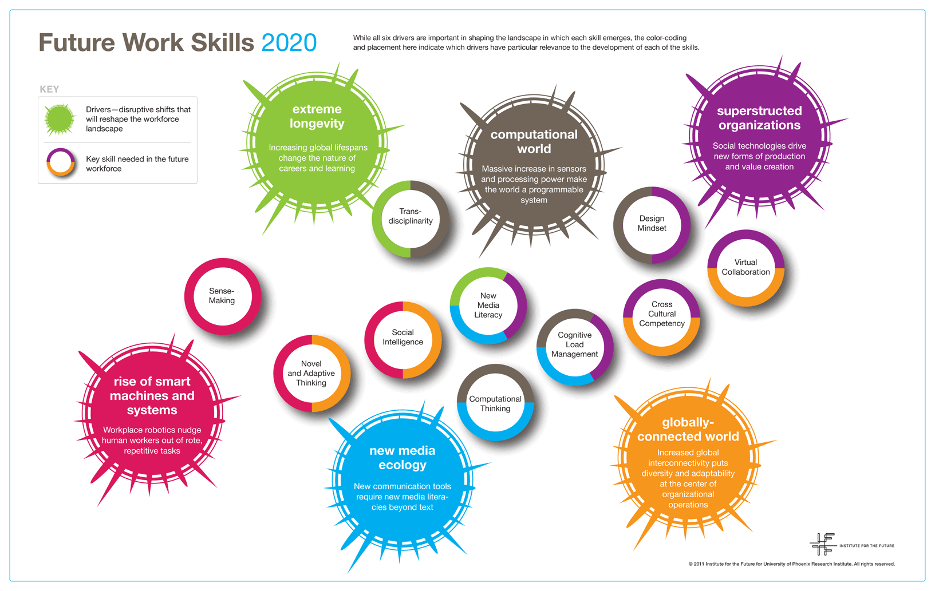
Step 2 :: How do the skills you imagined compare to the following from the IFTF?
Notes:
IFTF report from 2011
http://www.iftf.org/uploads/media/IFTF_FutureWorkSkillsSummary_01.gif
http://www.iftf.org/uploads/media/SR-1382A_UPRI_future_work_skills_sm.pdf
Updated IFTF report
http://www.iftf.org/fileadmin/user_upload/downloads/wfi/ACTF_IFTF_FutureSkills-infographic.pdf

Slide 11
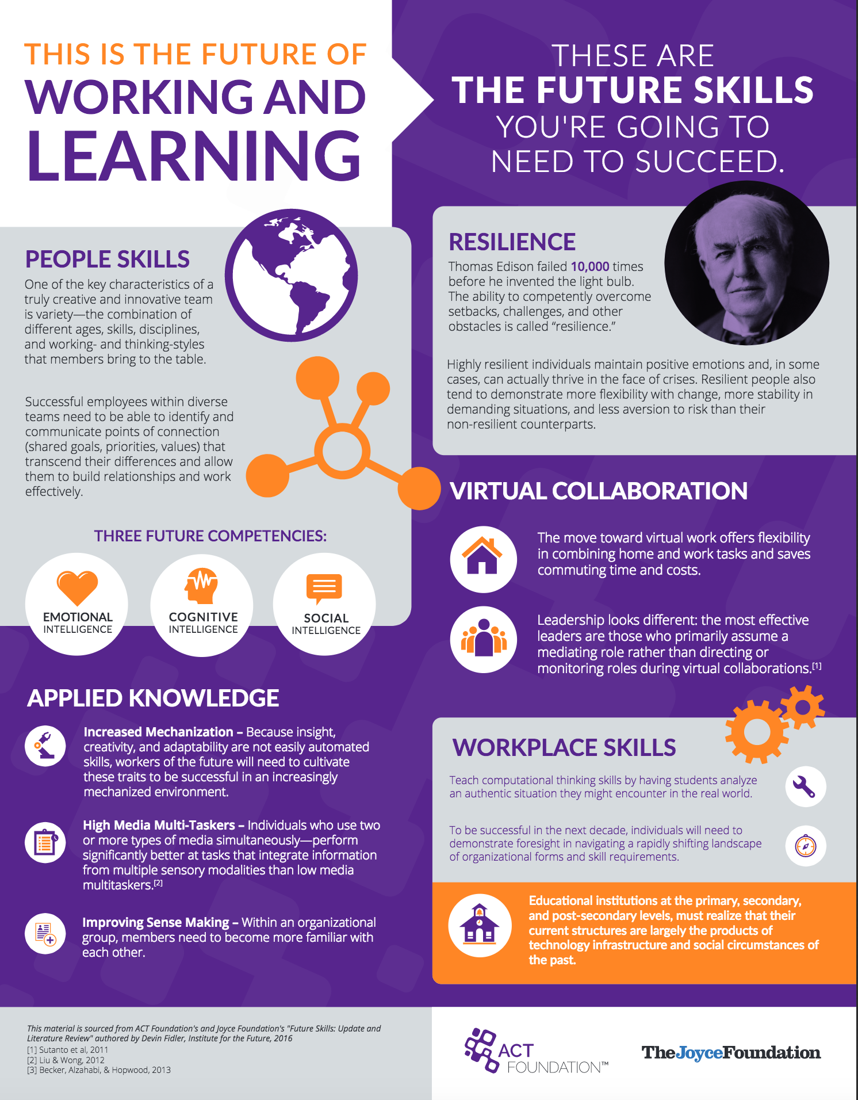
This report, Future Skills Update and Literature Review by Institute for the Future (IFTF), undertaken in partnership with ACT Foundation and Joyce Foundation, is an update to IFTF’s ongoing exploration of the kinds of skills that will allow people to thrive in the future. In 2010, IFTF authored a well-received report, Future Work Skills 2020. This work drew on the Institute’s ongoing research and expert workshops to chart the most powerful drivers of change in the ways that we work, and the skills likely to become relatively more important as these changes take shape.
Since then, the issues pointed to in that report, including increased automation, shifts in the culture of work, and new organizational models, are becoming more urgent. The timing is right to revisit the issue of future work skills. In particular, collaboration with ACT Foundation has allowed us to look much more deeply into each of the skills that industry leaders have highlighted as increasingly important for the world ahead.
Notes:
Updated IFTF report
http://www.iftf.org/fileadmin/user_upload/downloads/wfi/ACTF_IFTF_FutureSkills-infographic.pdf
https://equityinlearning.act.org/wp-content/uploads/2017/07/Future-Skills.pdf
https://equityinlearning.act.org/research-doc/future-skills/

Slide 12
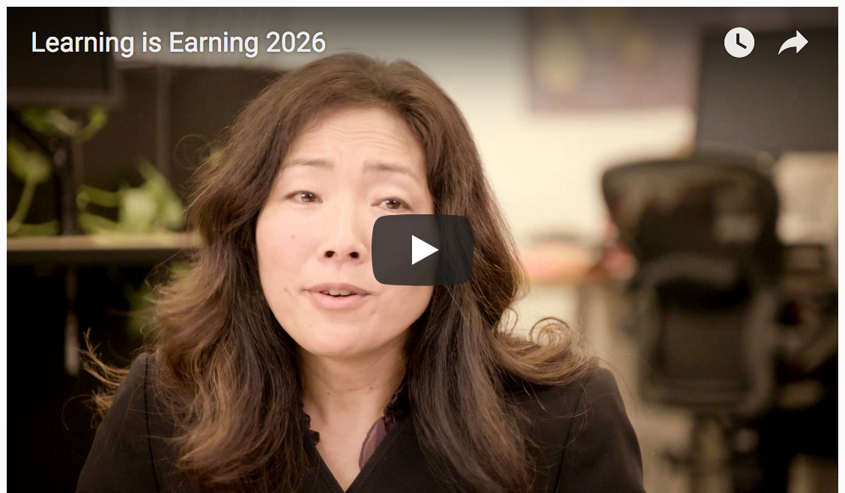
Step 3 :: Watch the following video. How might such skills come together with free education?
https://www.youtube.com/watch?v=DcP78cLPGtE&feature=youtu.be
Notes:
http://www.iftf.org/future-now/article-detail/iftf-launches-learn-and-work-futures-initiative-investigating-the-intersections-of-learning-workin/
http://www.iftf.org/learningisearning/

Slide 13
Write your name here this is the individual part of the assignment. Each team member does this slide.
POSITIVE IMAGINATION: What would you be excited to do in this future? What great things could happen?
Write your notes here. Limit yourself to 140 characters per idea. Write 3 positive imaginations.
Upload each post individually https://canvas.cmu.edu/courses/857/discussion_topics/25783
Notes:
Write your name here this is the individual part of the assignment. Each team member does this slide.
POSITIVE IMAGINATION: What would you be excited to do in this future? What great things could happen?
Write your notes on the slide. Limit yourself to 140 characters per idea. Write 3 positive imaginations.
Upload each post individually https://canvas.cmu.edu/courses/857/discussion_topics/25783

Slide 14
Write your name here this is the individual part of the assignment. Each team member does this slide.
SHADOW IMAGINATION: What are you worried about in this future? What could go wrong?
Notes:
Write your name here this is the individual part of the assignment. Each team member does this slide.
SHADOW IMAGINATION: What are you worried about in this future? What could go wrong?
Write your notes on the slide. Limit yourself to 140 characters per idea. Write 3 shadow imaginations.
Upload each post individually https://canvas.cmu.edu/courses/857/discussion_topics/25783

Slide 15
Step 5. Discuss LEARN!2050 scenario from Adam Gordon's Perspective.
http://onlinelibrary.wiley.com/doi/10.1111/drev.10273/pdf
Notes:
http://onlinelibrary.wiley.com/doi/10.1111/drev.10273/pdf
What are some of your key insights about Adam Gordon’s 10 critique points when applied to Arnold Wasserman’s LEARN!2050 scenario?

Slide 16
Step 6. Positive and Shadow imaginations about edu-block discussion.
Notes:
What are key discussion points from the positive and shadow imaginations for the learn/earn edublock scenario?

Slide 17
Step 7. LEARN!2050 & learn to earn edublocks
Notes:
You've explored LEARN! 2050 & Learn-Earn EDUBLOCKS. Mash-up features of LEARN!20150 & EDUBLOCKS that your team would like to explore. Brainstorm what a Future of Learning Scenario might be like.
What is the scenario like?
When is it situated in the future?
What learning artifacts or services are involved look like?
Where would your scenario be situated?
Who might be involved in your scenario (be inspired by your 3rd generation personas)[?
What are the roles involved (e.g., learner, teacher, worker, cat)?
What are people learning (e.g., STEM, Arts, Design, Humanities, Yoga, Tai Chi, Soccer, Bowling, DDR, )?

Slide 18
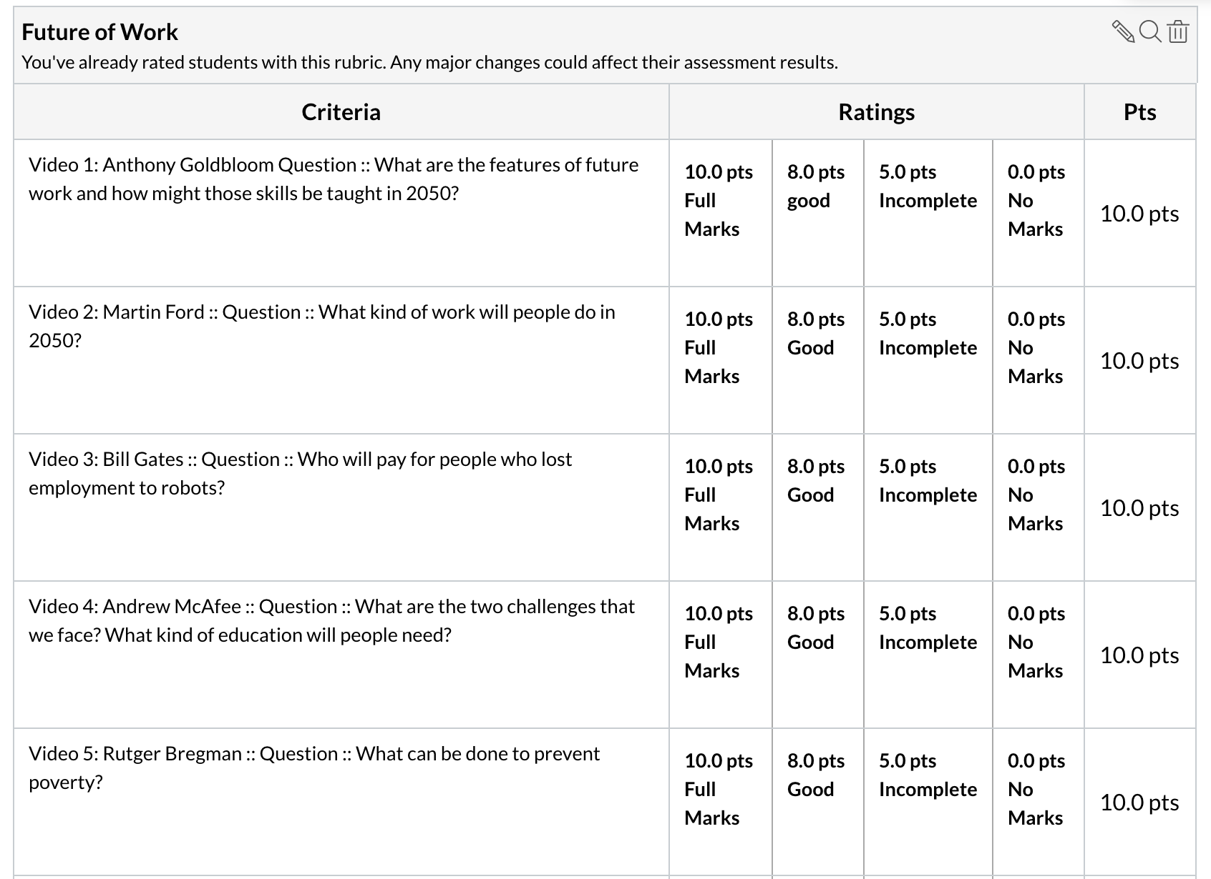
Rubric
Points: 120
Submitting: a website url

Slide 19
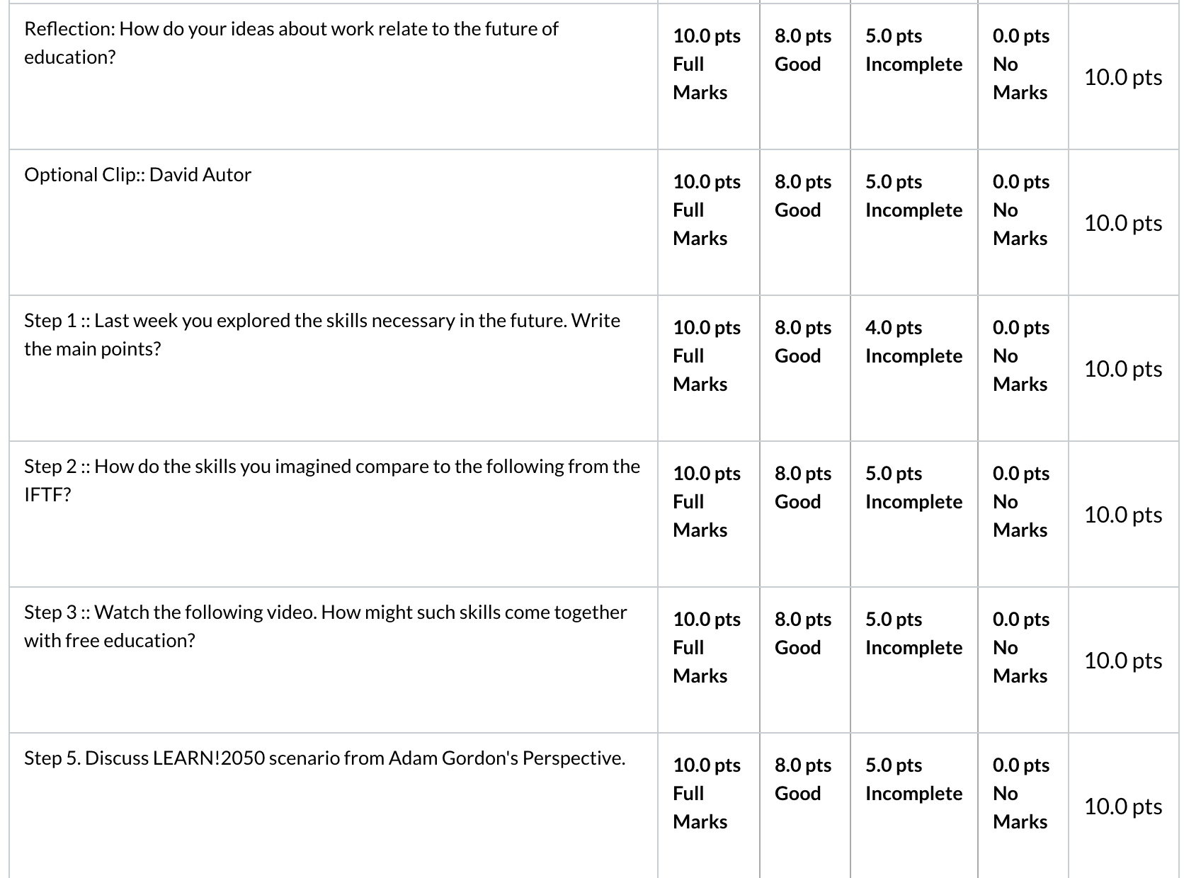
Rubric
Points: 120
Submitting: a website url

Slide 20
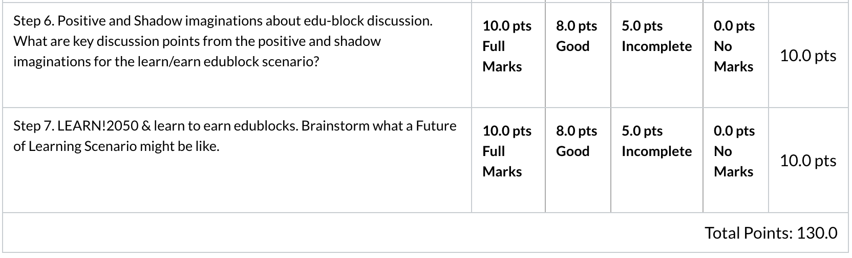
Rubric
Points: 120
Submitting: a website url

