Slide 1
Experiencing
Education Futures
Experiential Futures Exercise
Notes:
Last assignment of Dexign futures class activity.
(adapted from Stuart Candy’s “TIME MACHINE / REVERSE ARCHEOLOGY: Create an experience or artifact from the future” assignment. https://www.researchgate.net/publication/305333152_Time_Machine_Reverse_Archaeology

Slide 2
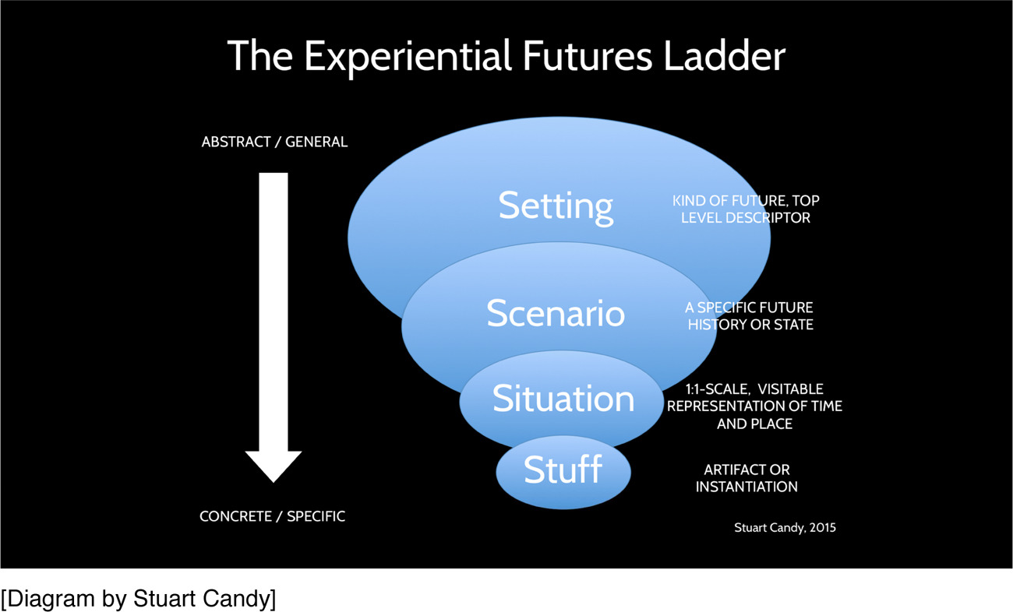
Theoretical framing of Experiential Futures:
Notes:
Stuart Candy developed the Experiential Futures Ladder to go from the abstract to the specific concrete instance (Candy & Dunagan, 2016). It has four levels that go from: (a) setting--the kind of future top level description of the world; (b) scenario-- a specific future history or state; (c) situation -- one-to-one scale visible representation of time and place; and (d) stuff-- artifacts or instantiations.
Figure 1. The Experiential Futures Ladder from Candy, Stuart & Dunagan, Jake (2016) Designing an experiential scenario: The people that vanished, Futures, (2016), http://dx.doi.org/10.1016/j.futures.2016.05.006

Slide 3
Step 0. Experiential Futures Ladder
 | definition | Fill in for your project
Setting | the kind of future top level description of the world
Scenario | a specific future history or state
Situation | one-to-one scale visible representation of time and place
Stuff | artifacts or instantiations
abstract
concrete
Notes:
To give you an overview of how the experiential futures ladder maps to the mission you are about to embark in for the future of learning experiential futures assignment.
You will fill this matrix to keep track of your team decisions.

Slide 4
Reverse Archeology & Time Machine
Reverse Archeology involves making an artifact, prototypes, environments, or communication from the future.
The Time Machine involves creating a performance to bring people into the future. It usually incorporates tangible artifacts as props and costumes.
Notes:
This is an overview of what you will make. You will make (1) artifacts, prototypes or communications from the future and (2) a five minute performance to bring people into the future.

Slide 5
Step 1. Describe the Setting for the future of education
Use Arnold’s Learn2050! and Institute for the Future’s Learning is Earning (Edublocks) Scenarios, D.School examples, as a starting points.
You’ve already explored the mechanics of how to implement different benchmark goals, critiqued the scenario, and familiarized yourself with the futures of learning design space. You’ve critiqued the scenarios. Please modify and expand the scenarios based on your critiques and insights from the past weeks. What is the setting for your scenario? The setting is the kind of future top level description of the world.
Notes:
11/14/2017
Use Arnold’s Learn2050! and Institute for the Future’s Learning is Earning (Edublocks) Scenarios as a starting points.
You’ve already explored the mechanics of how to implement different benchmark goals, critiqued the scenario, and familiarized yourself with the futures of learning design space. You’ve critiqued the scenarios. Please modify and expand the scenarios based on your critiques and insights from the past weeks. What is the setting for your scenario? The setting is the kind of future top level description of the world.

Slide 6
Step 2. What is the specific future history or state
Select a scenario snipet within Arnold’s Learn2050! Futures article and Learning is Learning to work on. Remember a scenario is a specific future history or state.
Stretch plausibility -- but don’t break it. Use Dator’s second law of futures. “Any successful statement about the future should at first appear to be ridiculous.”
Write out the setting, and scenario you are going to explore. Remember it should be something that is linked to a “benchmark goal” for 2050, and has “futures signs” that you explored previously (e.g., you worked on linking the benchmark goals to futures signs).
You also identified the four CLA layers to the present state and LEARN2050! future in that assignment (i.e., (a) litany, (b) social / expert systems, (c) worldview, (d) myths & stories).
Notes:
11/14/2017
Select a scenario snipet within Arnold’s Learn2050! Futures article and Learning is Learning, and Stanford D. School to work on. Remember a scenario is a specific future history or state.
Stretch plausibility -- but don’t break it. Use Dator’s second law of futures. “Any successful statement about the future should at first appear to be ridiculous.”
Write out the setting, and scenario you are going to explore. Remember it should be something that is linked to a “benchmark goal” for 2050, and has “futures signs” that you explored previously (e.g., you worked on linking the benchmark goals to futures signs .
You also identified the four CLA layers to the present state and LEARN2050! future in that assignment (i.e., (a) litany, (b) social / expert systems, (c) worldview, (d) myths & stories).

Slide 7
Step 3. Generate multiple premises.
Assume that the scenario you read has come to pass. What problems have lessened or gone away. Which problems have appeared or worsened?
What activities stopped or diminished?
What are surprising things that do not exist today?
Reverse Archeology What artifacts, products, environments, or communications from the future might best help a visitor understand the future scenario? Some artifacts might be articles, postcards, packaging, newspapers, websites, etc.
Time Machine (4-5 minute performance) What specific situations might transport viewers into your future?
Notes:
11/16/2017 Thursday
Assume that the scenario you read has come to pass. What problems have lessened or gone away. Which problems have appeared or worsened?
What activities stopped or diminished?
What are surprising things that do not exist today?
Reverse Archeology What artifacts, products, environments, or communications from the future might best help a visitor understand the future scenario? Some artifacts might be articles, postcards, packaging, newspapers, websites, etc.
Time Machine (4-5 minute performance) What specific situations might transport viewers into your future?

Slide 8
Step 4. Choose your premise.
What is the most captivating “tip of the iceberg” premise that can help the viewers imagine the larger scenario (within the constraints you are working within: time, resources, tools, skills, space available).
Notes:
11/21/2017
What is the most captivating “tip of the iceberg” premise that can help the viewers imagine the larger scenario (within the time, resources, tools, skills, space available).
What

Slide 9
Step 5. brainstorm your artifact / experience.
Create a story world. Seek to create a story that is cohesive and whole. Put the audience in the world of the scenario and keep us there. Don’t break the universe.
Reverse Archeology What you make should be “from the future” not about the future. Make something that looks, feels, and behaves as if it had just been time transported back to us. Evoke the story as compellingly and concretely as possible.
Time Machine You can use the projector, and sound system in the classroom. Consider background music and sound effects if they help. Are there hand outs or props for your performance (i.e., think of this as a skit or charade around the campfire)? How will you involve the audience in your performance?
Notes:
11/21/2017 Begin thinking about the story world that you want to create. You will need several things: storyboards, script, sketches of artifacts, communications, and services from the future. Assign a task to each team member. Each team member will work on a slide to develop drafts during Thanksgiving break.
Create a story world. Seek to create a story that is cohesive and whole. Put the audience in the world of the scenario and keep us there. Don’t break the universe.
Reverse Archeology What you make should be “from the future” not about the future. Make something that looks, feels, and behaves as if it had just been time transported back to us. Evoke the story as compellingly and concretely as possible.
Time Machine You can use the projector, and sound system in the classroom. Consider background music and sound effects if they help. Are there hand outs or props for your performance (i.e., think of this as a skit or charade around the campfire)? How will you involve the audience in your performance?

Slide 10
Step 6. List of tasks for Thanksgiving break
tasks | name
storyboard
script
artifact sketches
costumes / roles
Notes:
Please assign tasks to your team members. This is a divide and conquer strategy. Each team-member is responsible to bring a draft of their task to class so that it can be critiqued. Please bring the task done in class Tuesday 11/28

Slide 11
Storyboard draft (write your name)

Slide 12
Script draft (write your name)

Slide 13
Artifact sketches (write your name)

Slide 14
Costumes and roles (write your name)

Slide 15
Step 7. Revised & Integrated, Storyboard, Script, Artifacts, Costumes & Roles
tasks | name
storyboard
script
artifact sketches
costumes / roles
Notes:
Due 11/30/2017

Slide 16
Revised Storyboard draft (write your name)

Slide 17
Revised Script draft (write your name)

Slide 18
Revised Artifact sketches (write your name)

Slide 19
Revised Costumes and roles (write your name)

Slide 20
Step 8a. Experiential Futures Ladder
 | definition | Description from Step 0 | Revised description
Setting | the kind of future top level description of the world
Scenario | a specific future history or state
Situation | one-to-one scale visible representation of time and place
Stuff | artifacts or instantiations
abstract
concrete
Notes:
To give you an overview of how the experiential futures ladder maps to the mission you are about to embark in for the future of learning experiential futures assignment.
You will fill this matrix to keep track of your team decisions.

Slide 21
Step 8b. re-Revised & Integrated, Storyboard, Script, Artifacts, Costumes & Roles
tasks | name
storyboard
script
artifact sketches
costumes / roles
Notes:
Due 11/30/2017

Slide 22
re-Revised Storyboard draft (write your name)

Slide 23
re-Revised Script draft (write your name)

Slide 24
re-Revised Artifact sketches (write your name)

Slide 25
re-Revised Costumes and roles (write your name)

Slide 26
Step 9. Final Storyboard, Script, Artifacts, Costumes & Roles
tasks | name
storyboard
script
artifact sketches
costumes / roles
Notes:
Due 12/05/2017

Slide 27
Final Storyboard draft (write your name)

Slide 28
Final Script draft (write your name)

Slide 29
Final Artifact sketches (write your name)

Slide 30
Final Costumes and roles (write your name)

