Slide 1
(your name) personal futures
Step 1. Brainstorm the careers you considered before signing (hey there!) up on your current major?
e.g., medicine, law, engineering, computer science, ballet, art, drama, architecture, and so forth.
Step 2. Consider two alternative careers you entertained most seriously before deciding to study your current major. Place design (or your major) and the other option you entertained.
For example, my uncle was a physician in Northern Italy. He used to do house visits in the countryside. I'd go with him on those trips and thought I'd love to be a doctor too when I grew up. So in high school I did lots of advanced biology and science and math classes. I also studied for 2.5 years journalism, studied drafting, sculpture for 2.5 years, did lights and sounds for school plays and school dances. I was fascinated by science and medicine but recognized that many of my interests were more on the creative side. My childhood hero was Leonardo Da Vinci. And, I loved to make drawings of my fantastical inventions. Ultimately, I decided to study architecture school for one year thinking that in the worst case scenario I could switch to pre-med in my second year. In my case I'd put on one end [architecture / design] and on the other [medicine / healthcare]
architecture / design <------------------------------------> medicine / healthcare
What are the two alternative careers you considered most seriously?
Notes:
Please edit the slide above. (feel free to delete my example text)

Slide 2
Step 3. Now consider another axis of uncertainty linked to your profession.
In my case it might be “practice” vs. “research”. Put that on a vertical axis
so draw the 2x2.
(a) professional practice (b)
^
|
|
architecture / design <------------------------------------> medicine / healthcare
|
|
V
(c) research (d)
Sketch out the four dimensions of your two career choices and critical uncertainties.
Fill out steps 1,2,3 on the next slide.
Notes:
What were the different careers you were considering?
Art vs Design?
Engineering vs. Design?
How do those two careers differ?
Professional practice vs research?
Large company vs small studio?
Private vs Government?

Slide 3
Axis 1 dimension 1
Name it!
Name it
(b)
Axis 2 dimension 1
Axis 2 dimension 2
(c) Name it!
Name it!
(d)
Axis 1 dimension 2
Notes:
Add a description of your personal alternative futures

Slide 4
Step 4. Now describe scenarios for what you might be doing in each quadrant. What forces might push you in one quadrant? What barriers might you encounter in that quadrant?
(a) architecture / design practice.
Would like to work in professional studios in big cities like Milan or San Francisco.
Not that interested in going to practice in my parents village or minor cities.
Very competitive work environments and low pay but high costs of living (Milan).
Mainly contract work, freelance, project contingent work.
------------------------------------------------------------------
Collaboration with Gruppo A12 - international exhibits.
Cognitive dissonance drafting during day - museum exhibit openings on nights and weekends.
Installations with new media artists.
(b) Medical practice
requires many years of very competitive education, residency years, specialization, etc.
seemed like less flexible professional training compared to design. --> hmm less likely to leave sector?
mapped to fewer interests of mine. --> more hobbies?
much more structured days and schedule.... Nights, weekends, etc.
(c) Design researcher. This is part of my current job. My active research areas are listed here.
https://www.learningenvironmentslab.org/member/peter-scupelli/
(d) Healthcare researcher. I never studied medicine. So this is a future that I didn’t deeply explore.
Except that my doctoral research was about Surgical Suites. So I did get to do research on healthcare.
Designing information hotspots for surgical suites: How architecture, artifacts, and people’s behavior converge to support coordination. Here is a copy if you want to read it.
I also spent two years working with professor Kristin Hughes on obesity prevention on her project called Fitwits. http://www.cmu.edu/homepage/health/2010/summer/the-fitwits-zones.shtml
Notes:
Delete my text above, and fill out your own descriptions of your own personal futures scenarios in the slide above.

Slide 5
Step 5. Select one of the four alternative personal futures you are most interested in exploring further.
Notes:
Describe one of the four alternative futures that you are interested in exploring further. We will do another exercise based on your choice in the next class.

Slide 6

Stop Here. We will pick this up on Thursday.
Notes:
Image credit ::
By United Nations - Vienna Convention on Road Signs and Signals, Public Domain, https://commons.wikimedia.org/w/index.php?curid=2630010

Slide 7
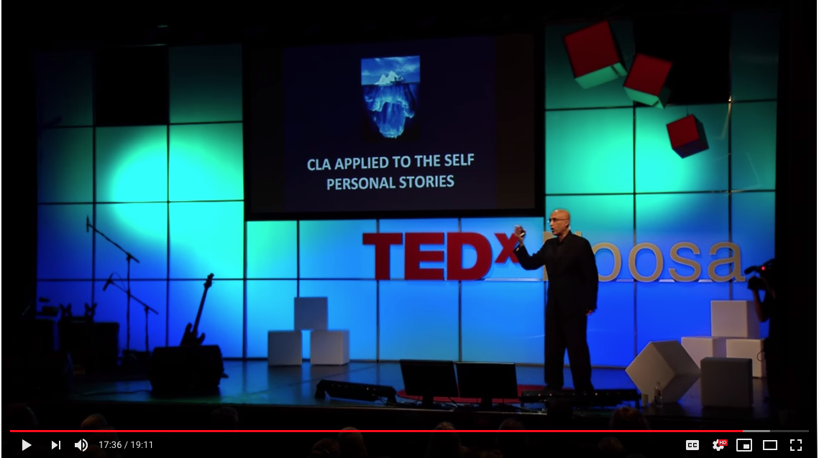
Notes:
https://youtu.be/ImWDmFPfifI

Slide 8
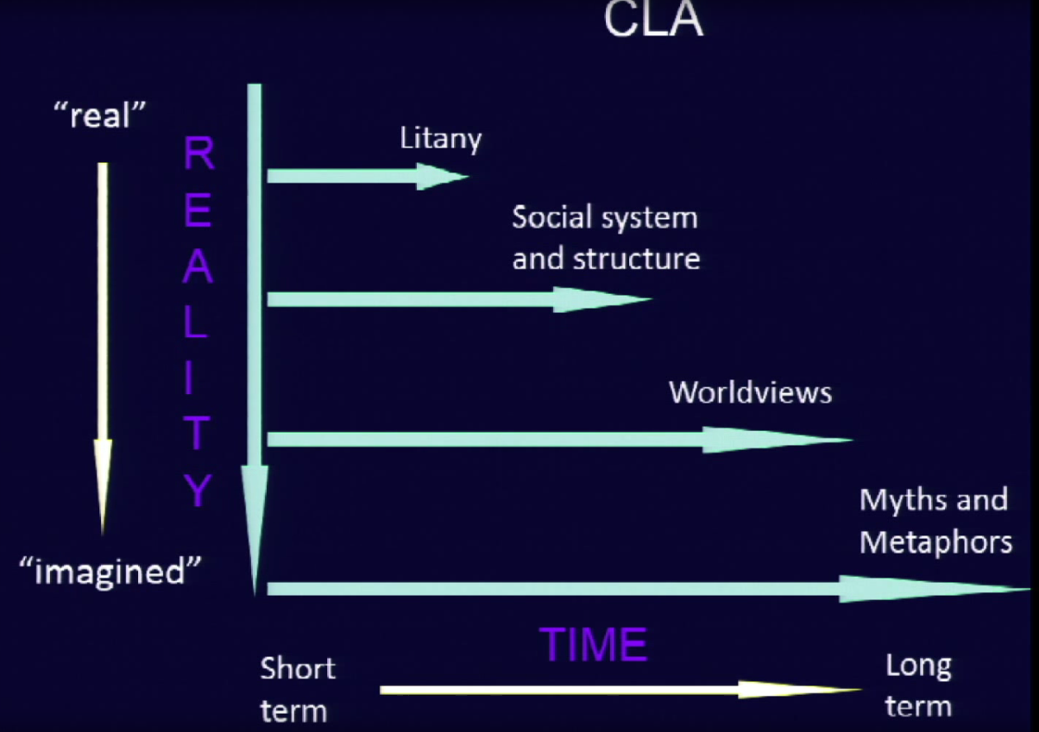
Notes:
CLA model reminder

Slide 9
Step 7 :: What is the social structure that you imagine in your personal future?
Notes:
Found at the second level of analysis where scholarly, political, or ideological interpretations are provided. What kind of system might you find yourself in? What might expert opinions about that system be about?

Slide 10
Step 8 :: What is the worldview that you imagine embodied in your personal future? Is that a desirable or unhelpful worldview? In other words, would you be happy inhabiting that worldview?
Notes:
The third is the foundation of fundamental beliefs and worldviews, often unexamined because to unpack this level, rich grounding in history, philosophy, religion, anthropology and the arts and humanities are required. What are some worldviews that you associate with your future scenario?

Slide 11
Step 9 :: What are the myths and stories that you imagine in your personal future? Are those desirable myths and stories for you? Do you feel motivated by the myths and stories or are you demotivated by them?
Notes:
The fourth layer is that of myth. It includes recurring themes such as the epic stories, unconsciously framing everything seen or said in the other three levels. Myths and mythic metaphors work at a pre-rational level and are perceived to be true within a culture. What are myths and metaphors that you imagine might be true in the future you’ve imagined for yourself?

