Slide 1
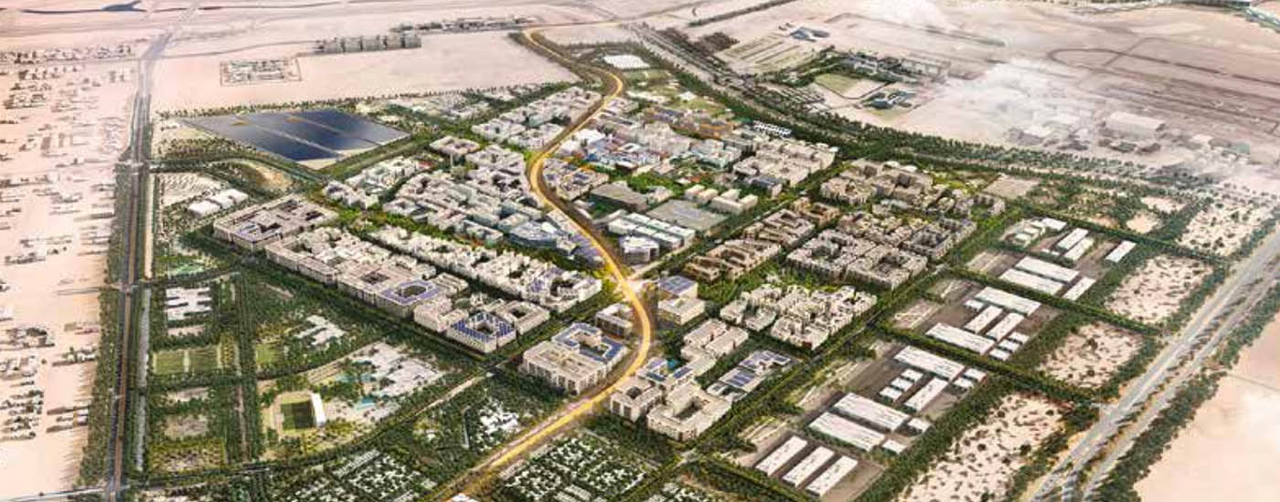
Masdar city
A sustainable city near in the United Arab Emirates
Notes:
Image credit: https://www.worldgbc.org/news-media/saint-gobain-build-%E2%80%9Cpositive-energy%E2%80%9D-home-masdar-city
More details:
https://en.wikipedia.org/wiki/Masdar_City

Slide 2
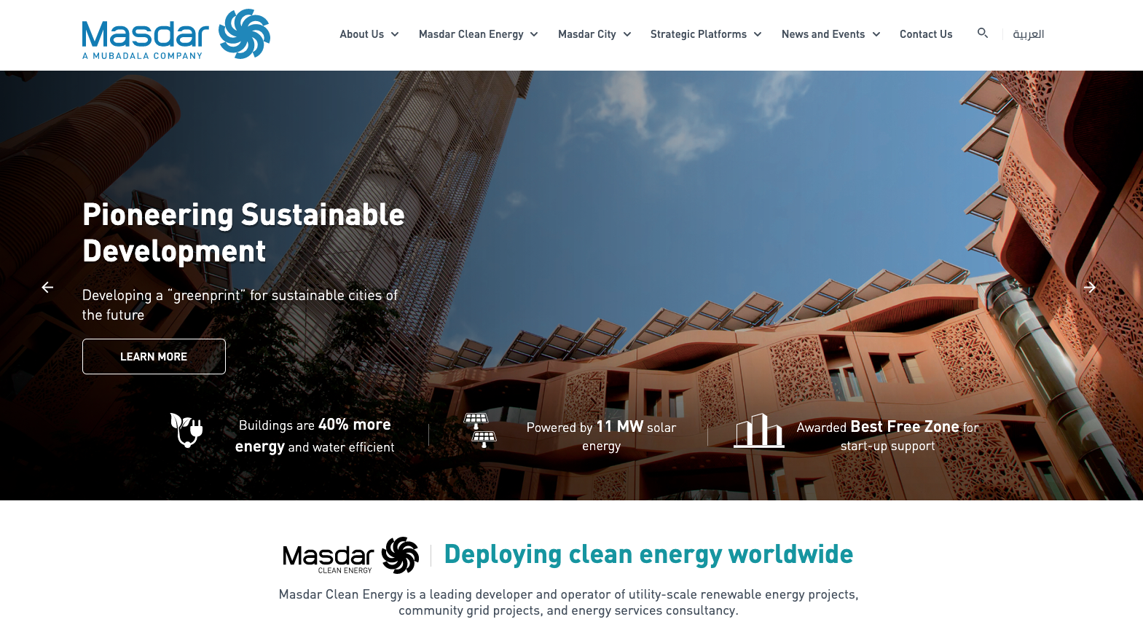
Notes:
Reference: https://masdar.ae/en/masdar-city/the-city

Slide 3
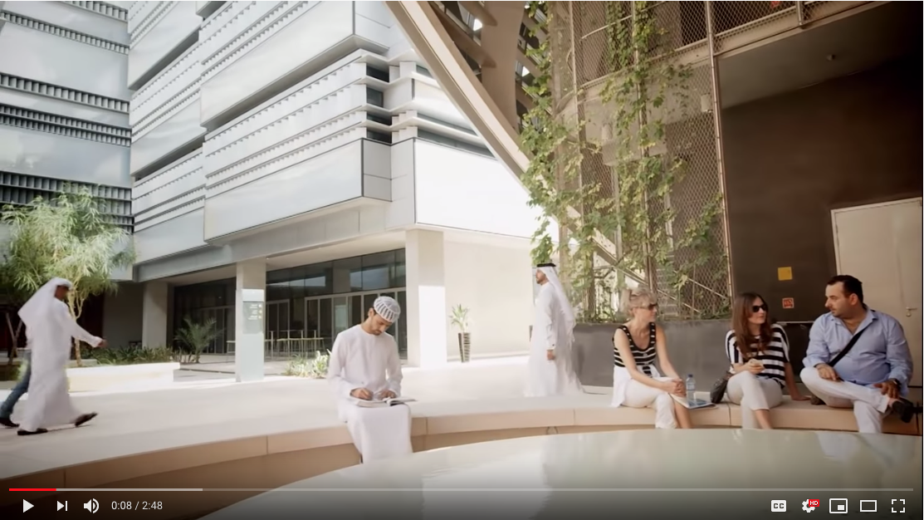
https://youtu.be/Llzq9YMsPP8
Notes:
https://youtu.be/Llzq9YMsPP8
Reference: https://masdar.ae/en/masdar-city/the-city

Slide 4
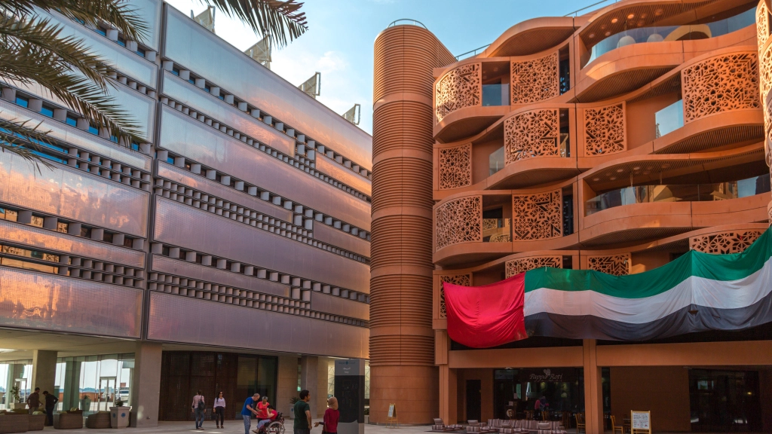
Notes:
Image credit: https://www.arup.com/projects/masdar-city

Slide 5
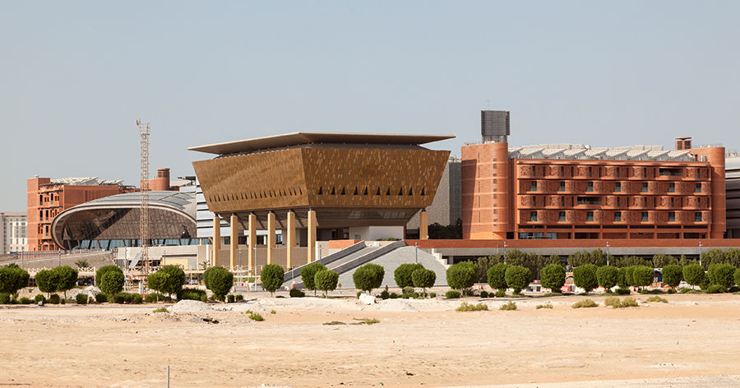
Notes:
Image Credit: https://www.honeywell.com/en-us/newsroom/news/2017/09/welcome-to-masdar-city

Slide 6
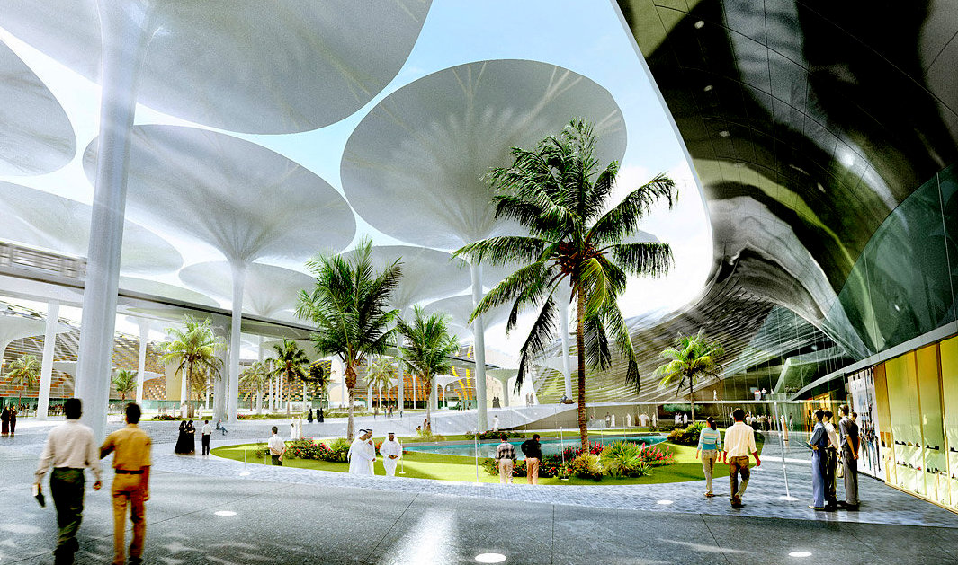
Notes:
Image credit: https://fossbytes.com/know-masdar-city-worlds-first-zero-carbon-city/

Slide 7
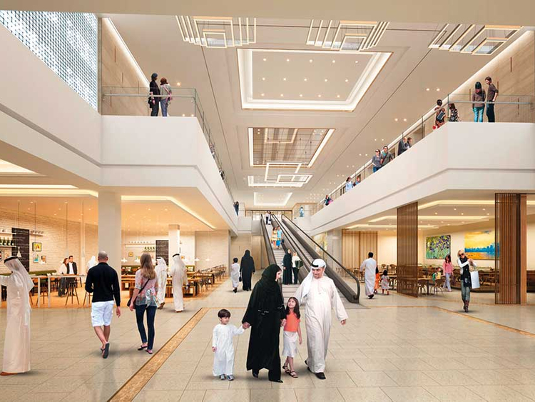
Learning objectives
Critically analyze a future signal such as Masdar according to five STEEP forces of change.
Identify a challenge or problem that has implications for the people who will live in Masdar in 2050 should it grow to 3 million inhabitants.
Design specific solutions to the problem that will make those people’s lives better.
Use a storyboard sketch to propose your design solution to the Masdar creators.
Brainstorm five concepts related to the problem/solution you identified.
Notes:
Image credit: https://gulfnews.com/business/retail/city-centre-in-masdar-to-open-in-q2-2019-1.2194816

Slide 8
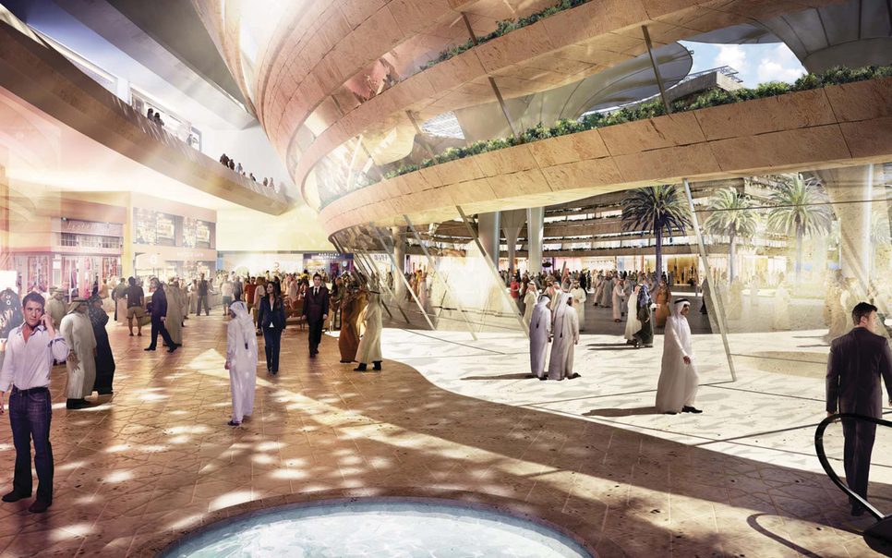
Evaluation criteria
(1) Student provides pros and cons for all five STEEP forces.
(2) Student identifies an interesting and concrete aspect, problem, opportunity, or issue
(3) Student storyboards a day-in-the-life experience with the problem they identified for Masdar.
(4) Student storyboards a day-in-the-life revised experience with the problem they identified for Masdar.
(5) Student provides five concept ideas for new products or services. There is a sketch for each concept and caption to describe.
Notes:
Image credit: https://www.constructionweekonline.com/article-42556-majid-al-futtaim-to-open-new-mall-in-masdar-city

Slide 9
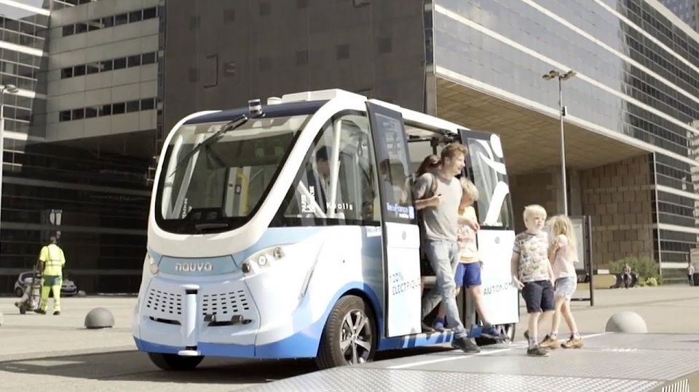
Notes:
Image credit: https://fossbytes.com/know-masdar-city-worlds-first-zero-carbon-city/

Slide 10
Step 1: What might be some pros and cons of Masdar from a STEEP perspective? Fill in the table below.
STEEP | Pros | Cons
Social
Technological
Economic
Environmental
Political
Notes:
Masdar design activity: You’ve just seen the SHELL documentary on the Masdar pilot city. Imagine that Masdar wants to grow to accommodate 3 million people. (a) Critically analyse what you just saw in Masdar according to the STEEP forces.

Slide 11
Step 2. Design opportunities
Write your answer right here for the question in the speakers notes.
Notes:
Identify one aspect, problem, opportunity, or issue that is of interest to you to explore further through the lens design. What aspect of the current Masdar pilot do you think would have difficulty scaling to 3 million people?

Slide 12
Step 3. Problem Storyboard
Caption frame 1. Explain what is going on the the first frame.
Caption frame 2. Explain what is going on the the first frame.
Caption frame 3. Explain what is going on the the first frame.
Notes:
Sketch a problem storyboard for what a day in the life experience might be like in Masdar with the problem or issue you identified. Provide captions for each frame.

Slide 13
Step 4. Solution Storyboard
Caption frame 1. Explain what is going on the the first frame.
Caption frame 2. Explain what is going on the the first frame.
Caption frame 3. Explain what is going on the the first frame.
Notes:
Provide a solution storyboard of what the improved experience you identified above might be like in Masdar. In short, what would a day-in-a-life look like if the problem you identified were solved. Provide captions for each frame.

Slide 14
Step 5. Brainstorm five concepts for products or services that solve the problems you’ve identified.
Number your concepts, and copy this slide as many times as needed.

Slide 15
Step 6. Homework
Add images of your process sketches here.
Notes:
Step (6) Masdar choose one of your concepts from Step 5. The one you find most interesting and inspiring (or are curious to develop).
Work at home to further explore and develop the concept.
Create an 11x17 paper representation that you can bring to class on Tuesday and pin-up, Bring a digital picture of it as well (You'll need to upload the digital image);

