Slide 1

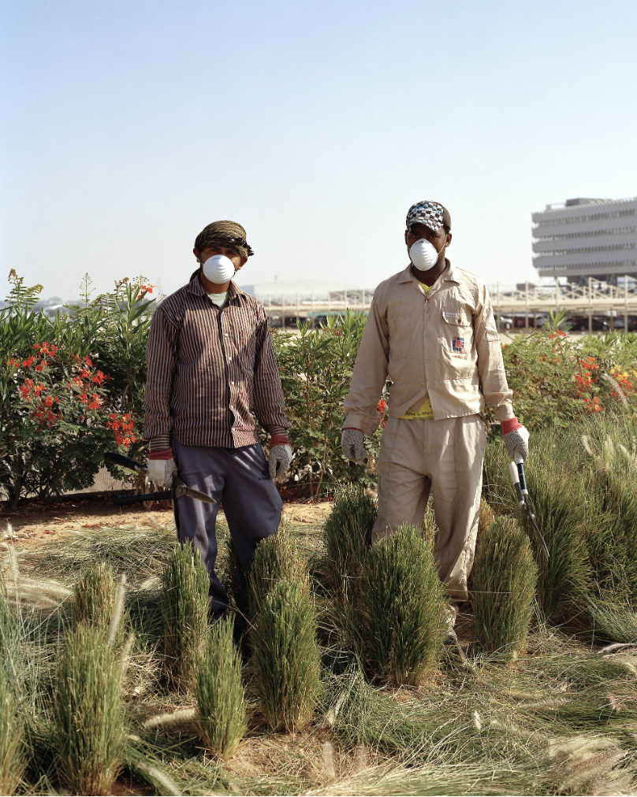
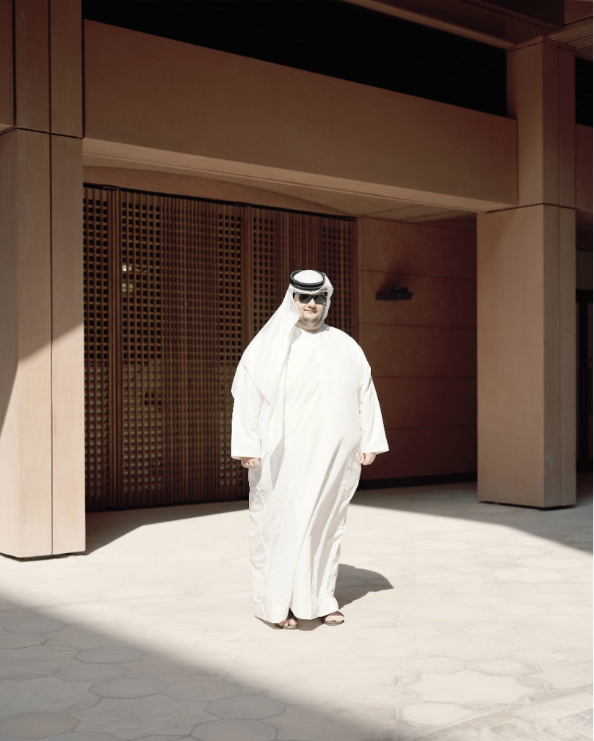
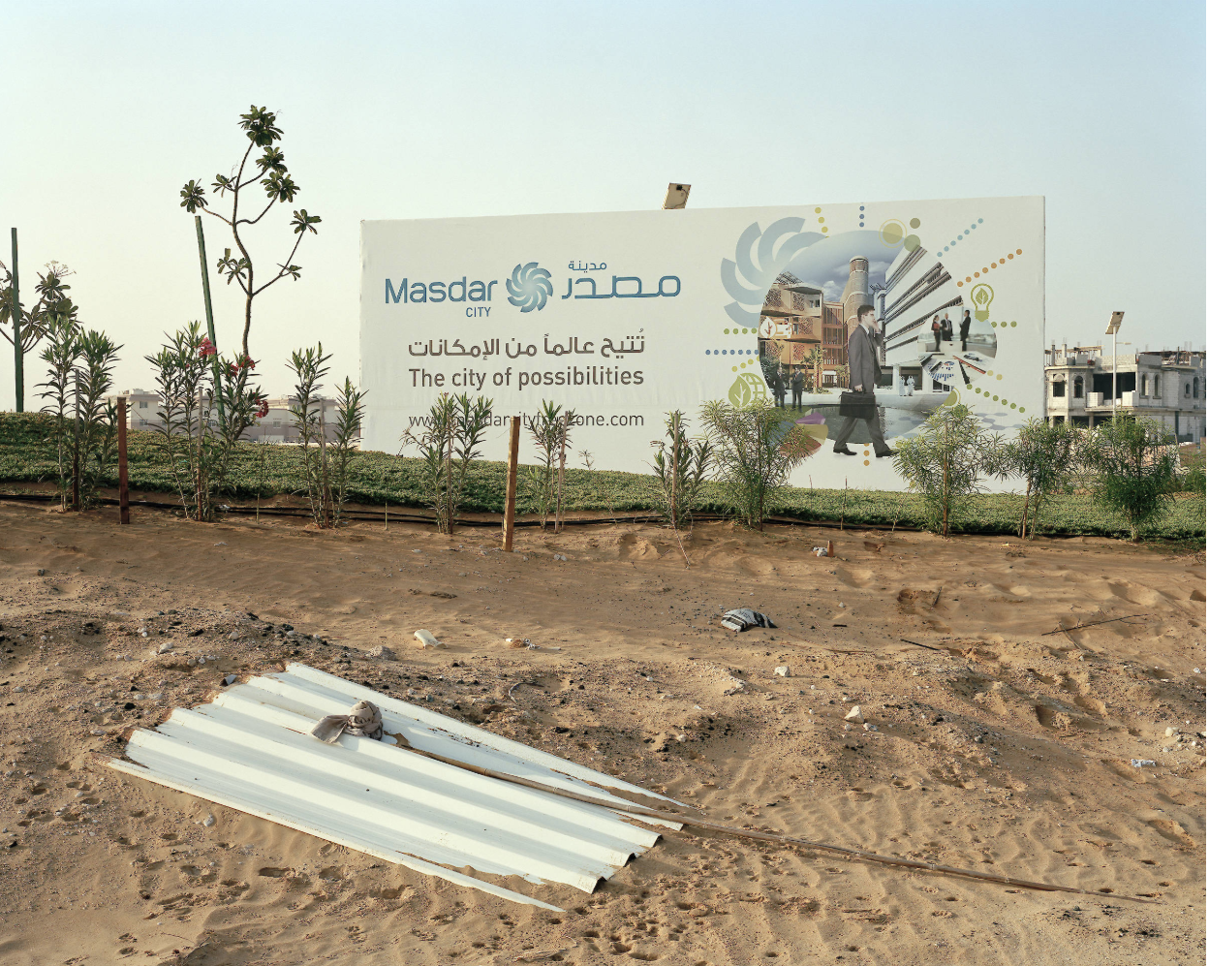
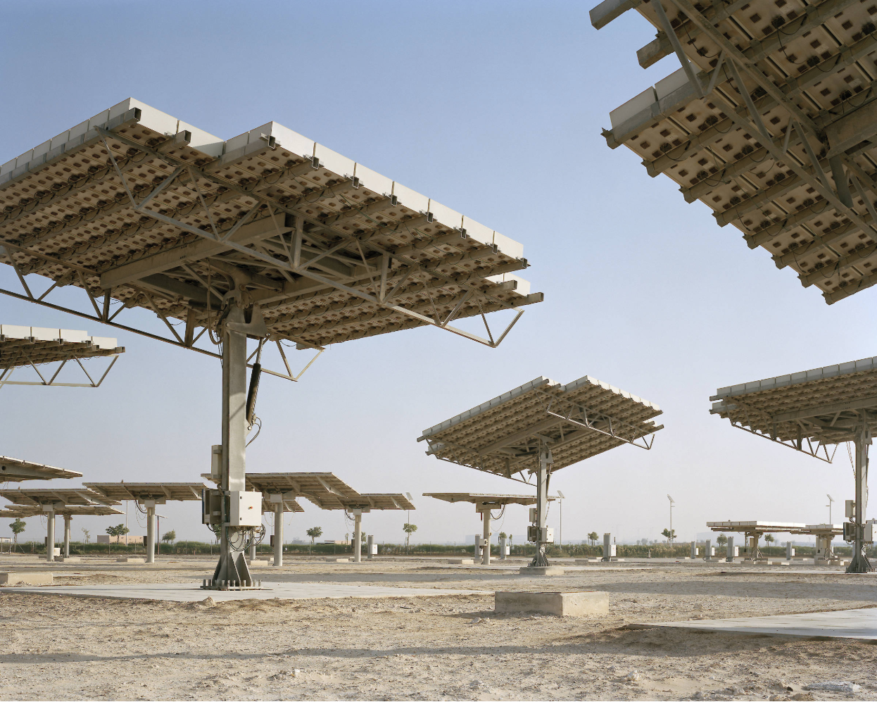
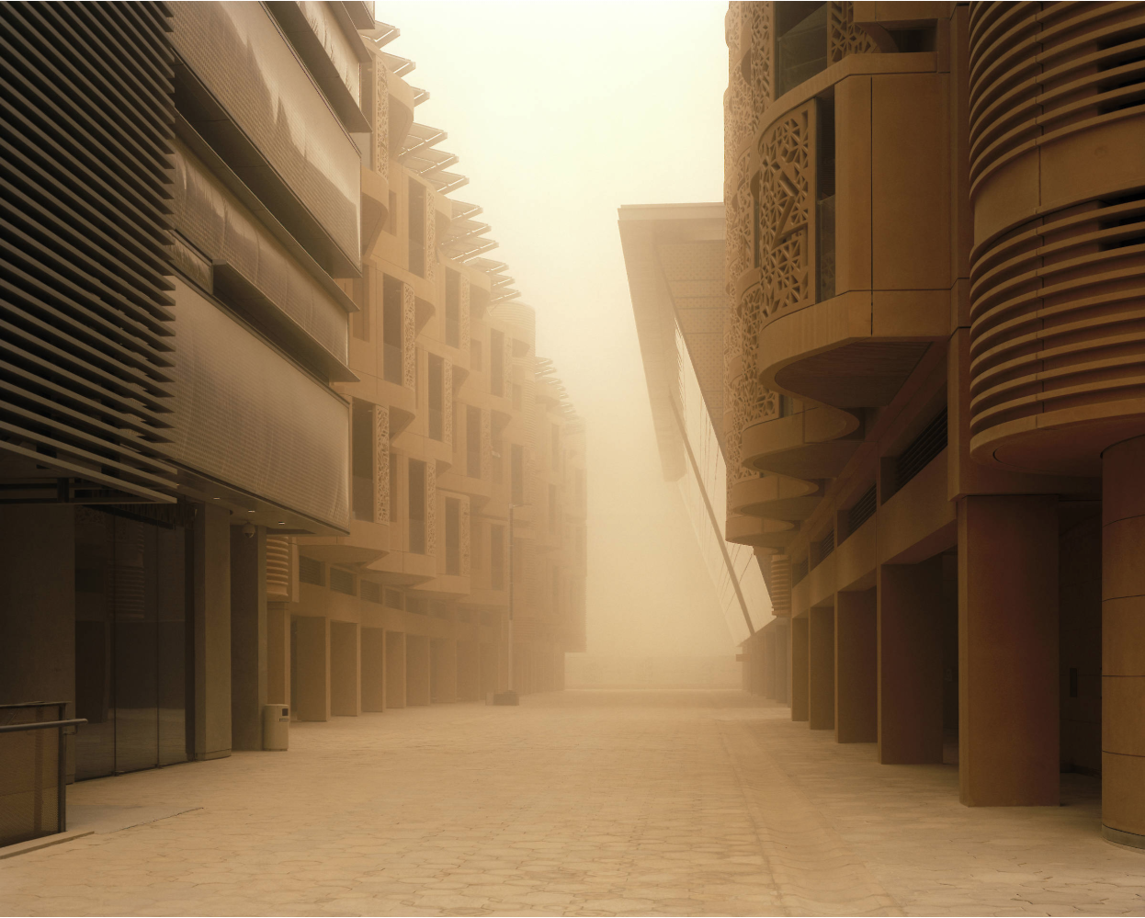
Obligations to future generations
Notes:
Image credits: http://www.etiennemalapert.com/#the-city-of-possibilities
Photographer Etienne Malapert says “In 2006, the United Arab Emirates (UAE) decided to undertake the crazy project of building an entire city in the middle of the desert. Masdar City’s first aim is to reach 0% CO2 emissions and be recognized as a “Green City”. London architectural firm Foster + partners designed this huge project, at a time of growing environmental concerns, especially about energy consumption and pollution. Despite holding a major share in global oil and gas production, the United Arab Emirates wish to change their image to showcase green technology and so called clean energy. Located 25 km south from Abu Dhabi, Masdar City is destined to be within the next 15 years the first self-ecological city in the world, with a population of 50,000 and a business hub of 1,500. Currently, only a few buildings have already emerged from the sand, including a scientific university, research laboratories and offices of major multinational corporations such as Siemens. The country launched the Masdar project as part of an economic policy shift called Economic Vision 2030, based on renewable energy and complex denser made research and developments. Following this trend, the government, in collaboration with UAE Oil Company, one of the world most influential one, have invested nearly $20 billion in the project. The real purpose of this commercial association is to establish the UAE as a pioneer in the renewable energy sector to complement its current status of “major oil exporter”. The beginning of the 21th century forces human-kind into a mutation stage of its evolution. Despite the need to shift paradigms towards greener economies and energy transition, no one can ignore this contradiction in terms: the world’s flag ship for green urbanism is spirited forward by one of the world’s largest producer of “black gold”.”

Slide 2
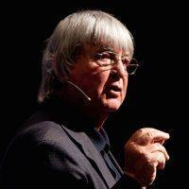
Whatever the truth of the matter here, we are for the first time faced with a new ethical question for which neither the wisdom of our ancestors nor the advocates of continual progress have a satisfying answer. And that ethical question is: “What are the obligations of present generations towards future generations?”
By “future generations” we do not mean our own children and grandchildren. That is far too easy. Of course we care about them! (Or do we? Look at the abused and neglected children all around us now!)
By “future generations” we mean all future life, everywhere, and forever--from here to eternity. And not just human life, but all future life of all kinds.
Jim Dator
Notes:
Image credit: https://miscmagazine.com/author/jimdator/
Reference: http://www.futures.hawaii.edu/publications/future-generations/Caring4FutureGenerations2007.pdf

Slide 3
Step 11. Obligations to future generations
How do you think Masdar engages with future generations*?
Answer here …..
Notes:
Based on your current understanding of Jim Dator’s article “Caring for Future Generations” (2007) How do you think the Masdar project engages with our obligations to future generations?
*By future generations Jim Dator says “By “future generations” we mean all future life, everywhere, and forever--from here to eternity. And not just human life, but all future life of all kinds.”
Here is some relevant information on Masdar City:
https://en.wikipedia.org/wiki/Masdar_City

Slide 4
Step 12. How does your proposal for Masdar engage with future generations*?
Please explain how you think your concept for Masdar in Step 10 relates to future generations*?
Notes:
*By “future generations” we mean all future life, everywhere, and forever--from here to eternity. And not just human life, but all future life of all kinds.

Slide 5
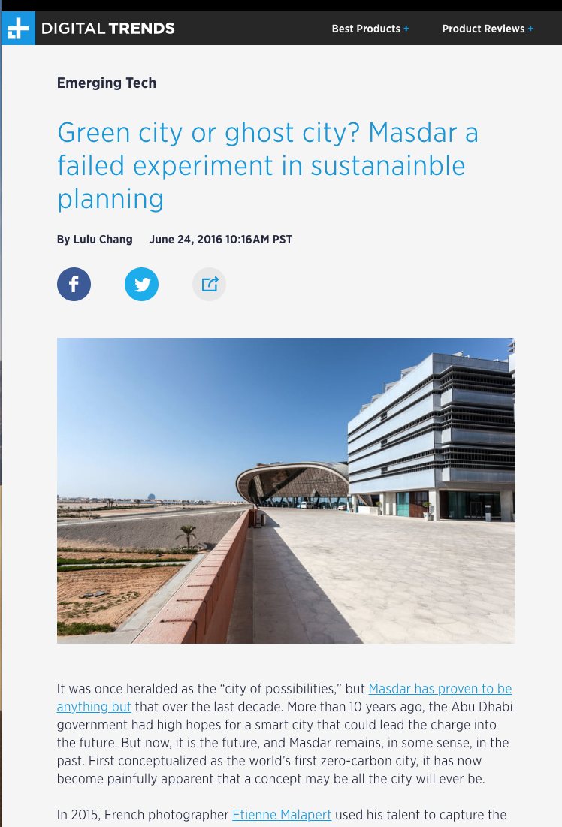
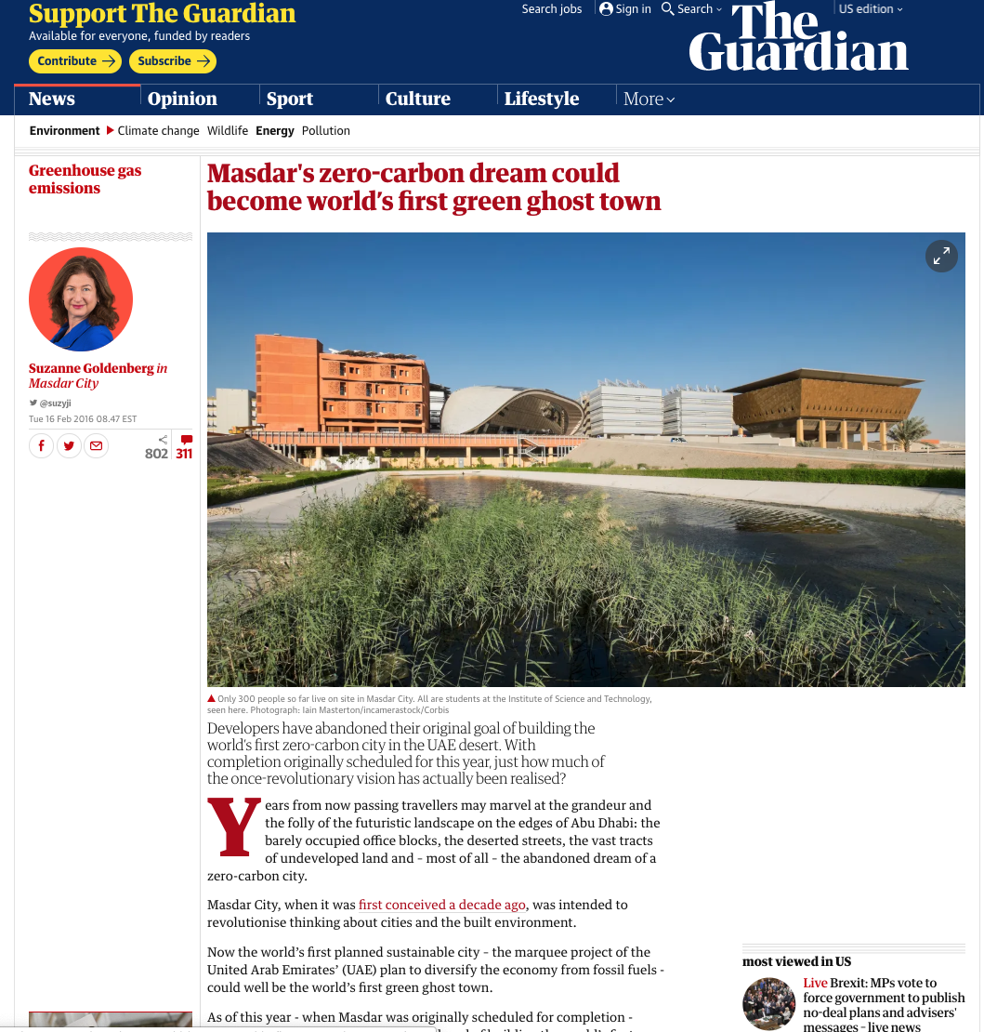
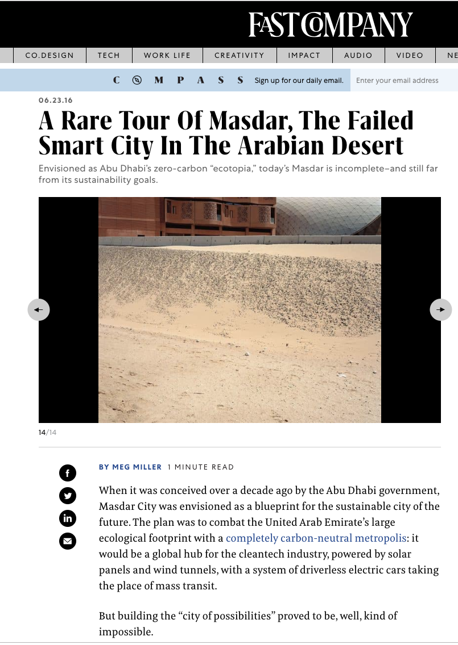
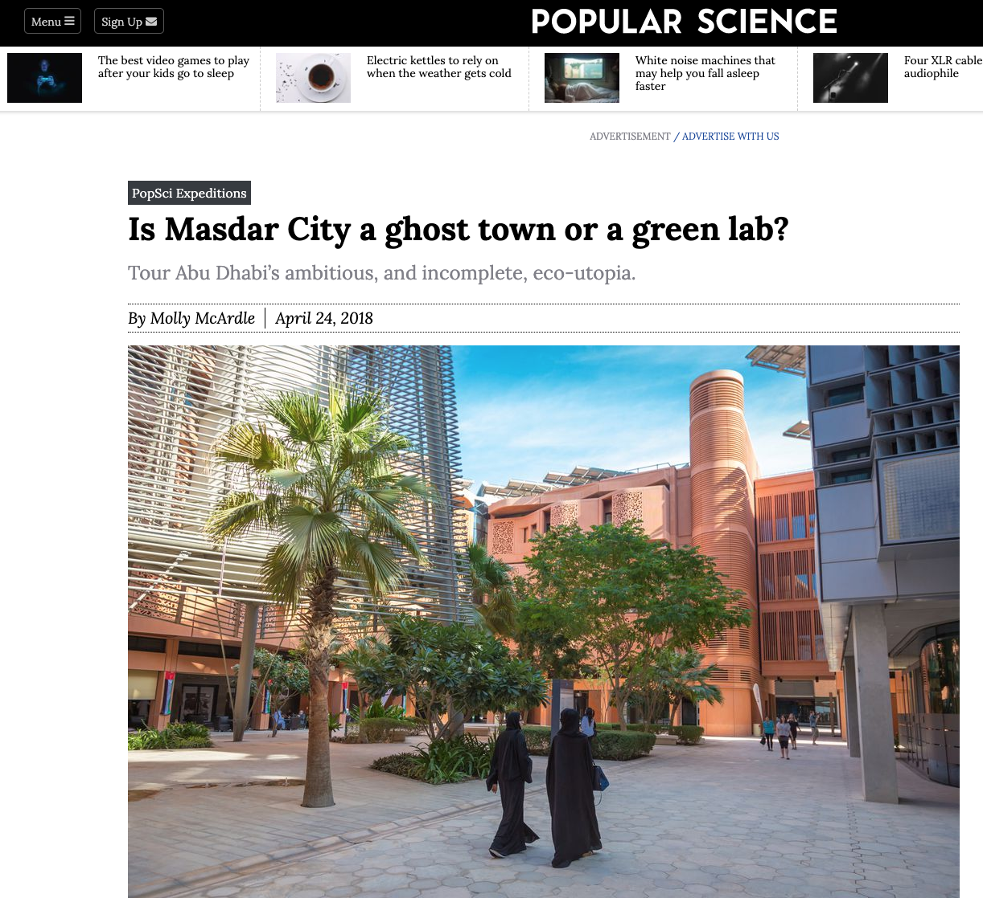
Step 13. Alternative futures for Masdar?
Notes:
Links:
https://www.fastcompany.com/3061187/a-rare-tour-of-masdar-the-failed-smart-city-in-the-arabian-desert
https://www.digitaltrends.com/cool-tech/masdar-green-city-adu-dhabi-failure/
https://www.popsci.com/masdar-city-ghost-town-or-green-lab/
https://www.theguardian.com/environment/2016/feb/16/masdars-zero-carbon-dream-could-become-worlds-first-green-gh

Slide 6
In what ways was Masdar described as a failure and in what ways is it successful?
Aspects that failed | Aspects that are successful
Notes:
Things didn’t really go as planned in Masdar. Below are at least three aspects:
2008 Global recession https://en.wikipedia.org/wiki/Masdar_City#Design_and_intent
PRT mobility scaled back https://web.archive.org/web/20131213234856/http://www.prtconsulting.com/blog/index.php/2010/10/16/why-has-masdar-personal-rapid-transit-prt-been-scaled-back/
Net Zero Carbon https://en.wikipedia.org/wiki/Masdar_City#Renewable_resources
Masdar successes:
https://abudhabisustainabilityweek.com/en/the-week/opening-ceremony
https://news.masdar.ae/en/youth
https://news.masdar.ae/
https://www.mubadala.com/en/what-we-do/renewables/masdar-city
https://news.masdar.ae/en/news/2019/08/26/12/49/public-art-of-the-sustainable-city
https://news.masdar.ae/en/news/2019/06/18/12/34/masdar-city---a-template-for-sustainable-urban-development
https://masdar.ae/en/masdar-city/business-at-masdar-city
https://www.companyincorporationdubai.com/masdar-city

Slide 7
Remember Jim Dator’s reading from OLI...
Dator, Jim. (2019). What Futures Studies Is, and Is Not. 10.1007/978-3-030-17387-6_1. http://www.futures.hawaii.edu/publications/futures-studies/WhatFSis1995.pdf
WHAT FUTURES STUDIES IS, AND IS NOT
IA. "The future" cannot be "predicted," but "alternative futures" can, and should be "forecast." Thus, one of the main tasks of futures studies is to identify and examine the major alternative futures that exist at any given time and place.
II. Any useful idea about the futures should appear to be ridiculous.
III. "We shape our tools and thereafter our tools shape us."
Notes:
Use the Dator’s three laws about futures to guide your thinking in the next slides...

Slide 8
Step 14. Alternative Futures (1)
You’ve pondered the pros and cons for Masdar City in step 13. The good news and bad news. What are some alternative futures that you can imagine for Masdar City? The goal for step 14 is to brainstorm 4 different alternative futures for year 2050. Describe one such future on this slide.
Notes:
Hint the STEEP forces can help you think of different futures. E.g., for example the economic downturn of 2008 impacted the economic factors of Masdar City as it was being built. What technological factors may have impacted the PRTs? What is the current political climate and what are alternatives for the future?

Slide 9
Step 14. Alternative Futures (2)
You’ve pondered the pros and cons for Masdar City in step 13. The good news and bad news. What are some alternative futures that you can imagine for Masdar City? The goal for step 14 is to brainstorm 4 different alternative futures for year 2050. Describe the second such alternative future on this slide.
Notes:
Hint the STEEP forces can help you think of different futures. E.g., for example the economic downturn of 2008 impacted the economic factors of Masdar City as it was being built. What technological factors may have impacted the PRTs? What is the current political climate and what are alternatives for the future?

Slide 10
Step 14. Alternative Futures (3)
You’ve pondered the pros and cons for Masdar City in step 13. The good news and bad news. What are some alternative futures that you can imagine for Masdar City? The goal for step 14 is to brainstorm 4 different alternative futures for year 2050. Describe the third such alternative future on this slide.
Notes:
Hint the STEEP forces can help you think of different futures. E.g., for example the economic downturn of 2008 impacted the economic factors of Masdar City as it was being built. What technological factors may have impacted the PRTs? What is the current political climate and what are alternatives for the future?

Slide 11
Step 14. Alternative Futures (4)
You’ve pondered the pros and cons for Masdar City in step 13. The good news and bad news. What are some alternative futures that you can imagine for Masdar City? The goal for step 14 is to brainstorm 4 different alternative futures for year 2050. Describe the third such alternative future on this slide.
Notes:
Hint the STEEP forces can help you think of different futures. E.g., for example the economic downturn of 2008 impacted the economic factors of Masdar City as it was being built. What technological factors may have impacted the PRTs? What is the current political climate and what are alternatives for the future?

