Slide 1
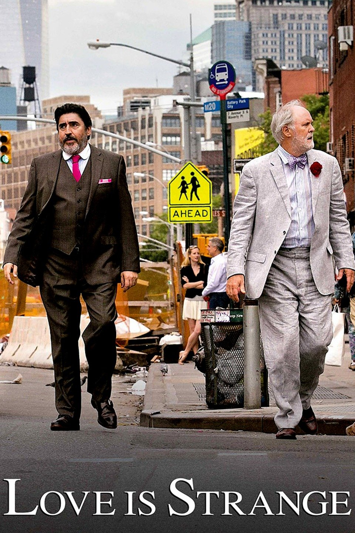


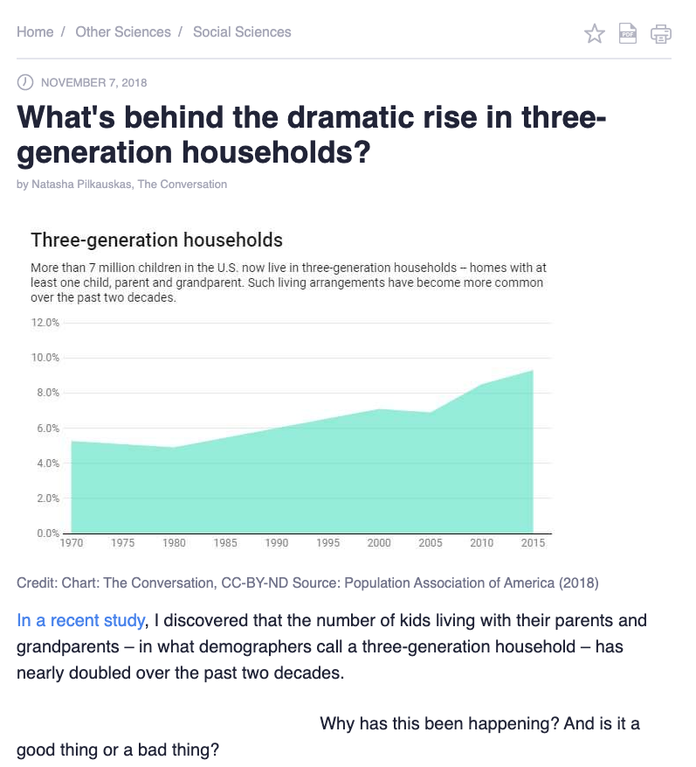
Three Generation
Persona Families
Notes:
Make sure to add your team number and team members.
Image credits: https://upload.wikimedia.org/wikipedia/en/7/74/3_Generations_poster.jpg
https://www.google.com/url?sa=i&source=images&cd=&ved=2ahUKEwjP0uiPnd3kAhXtzVkKHW9_BaUQjRx6BAgBEAQ&url=http%3A%2F%2Fgoogle.com%2Fsearch%3Ftbm%3Disch%26q%3DLove%2BIs%2BStrange&psig=AOvVaw3ZpdWvs5Gp2ViyOPDIF4gI&ust=1568994230684424
https://phys.org/news/2018-11-three-generation-households.html
https://www.gu.org/explore-our-topics/multigenerational-households/

Slide 2
Learning Objectives
1. Examine and record intergenerational challenges over time: past, present, and futures.
2. Create a three generation persona family to inform design opportunities.
3. Explore how STEEP forces played out for a family in the past, present, and speculate on futures.

Slide 3
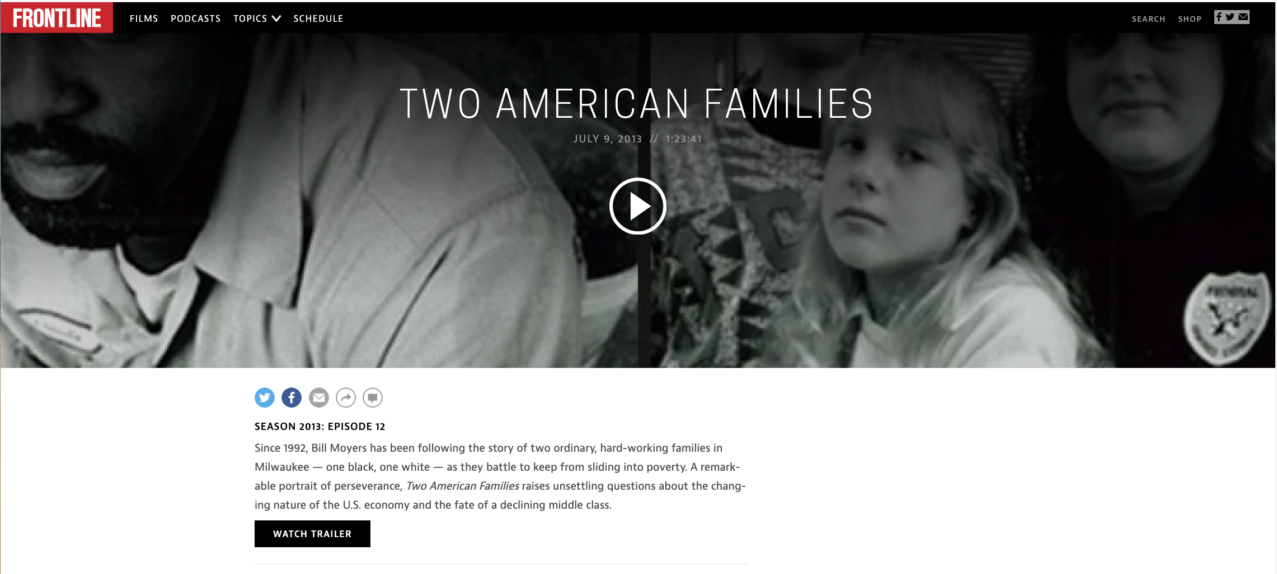
Introduction
The documentary Two American Families gave you a glimpse into how STEEP forces play out in peoples’ lives over time. The chronicling of the Stanley and Neumann’s over the past two decades gave you opportunities to see how Social, Technological, Economic, Environmental, and Political forces affect real people in the past. Hopefully, you are able to see how the present is affected by such forces as well. In this exercise you are going to imagine the future of the Stanley and Neumann families. In short, what happens from 2013 to 2050. As a designer you need to understand how STEEP forces shape the design space you are operating within. Things don’t just happen, forces of change shape the context where products, services, and experiences are launched. Aligning your work with such forces makes your design work more likely to succeed.
In this exercise you’ll go deeper into personas. Personas is a very powerful tool to communicate user research used by interaction designers. In this exercise you will learn how to avoid the major pitfall in making personas-- being too stereotypical and superficial.
Notes:
Image credit: https://www.pbs.org/wgbh/frontline/film/two-american-families/

Slide 4
Step 1.
Expand the family tree and timelines (Neumann or Stanley) past 2013 to 2050.
a. Add family members to include grandchildren and or great grandchildren (e.g., a third generation / fourth generation).
b. Pick one of the children to focus on (in the Stanley family you would pick Nicole, Keith, Klaudale, Claude Jr., or Omega. Picking Nicole or Keith (they have college degrees) is going to be a very different from picking Klaudale, Nicole, or Omega (they didn't go to college).
c. For example the Stanley family tree includes:
parents | Claude | Jackie
children | Nicole | Keith | Claude Jr | Omega
grandchildren | ? | ? | ? | ?
great grandchildren | ? | ? | ? | ?
Klaudale
Notes:
Fill out one of the family trees. The one you were working on previously.

Slide 5
Step 1 for the Neumann’s
The Neumann family tree includes:
parents |  | Tony | Terry
children |  | Karissa | Adam | Daniel
grandchildren | ? | ? | ? | ?
great grandchildren | ? | ? | ? | ?
Notes:
Fill out one of the family trees. The one you were working on previously.

Slide 6
Step 2. Update your timeline to include the grandchildren and great grandchildren listed above (You worked on this timeline in the previous class).
When are they born? What major events happened around their birth or marriages?

Slide 7
Step 3. Create a 2x2 map of the agency vs. gratification of your family members.
People make choices that affect their lives. Choosing to invest in short term vs long term has consequences. For example, taking the time to do your homework will cause immediate suffering (compared to playing a video game or watching Netflix) and long term gain when you show off what you learned and get a promotion (or funding for your start-up).
Sketch in the family members you met in the Frontline Documentary fall with regards to "agency (High/Low sense of personal agency)" and "gratification (immediate/long term gratification)"? What gaps are there in the 2x2? You might add your new family members to fill the gaps. If you need more explanations please see this document as mapped in page 4 of the document link.
 | Low personal agency | High personal agency
Long term gratification
Immediate gratification

Slide 8
Step 4. Persona Mandala.
How might you develop a persona that is believable and not just a superficial stereotype? Glad you asked, do step four to answer the question. Why do you want a believable persona you ask? Because believable personas are convincing. And good things happen to convincing people. So learn to be convincing and your career will take care of you.
Create a persona mandala that helps you explain what the persona cares about and what is motivating. Who should you focus on for the persona mandala?
An existing person from the documentary or a fictional grandchild or great grandchild?
It is better to focus on the grandchildren and great grandchildren in your persona mandala than focusing on the children or parents. Remember your persona needs to fit into the family you met in the Frontline documentary. This is a part fictional exercise. Much information is missing in the documentary. But your fiction should be built on the facts presented in the documentary.
In depth details about how to make a persona mandala.

Slide 9
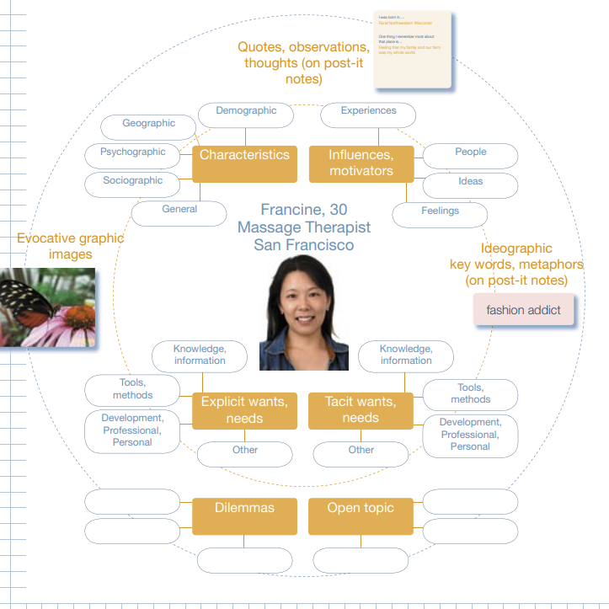
Sample persona mandala

