Slide 1

Future signs, signals, etc

Slide 2
Introduction
You’ve just experienced some future signs around minimalism, post-consumerism, zero-waste lifestyles, and so forth. What do those future signs mean for designers? How might you develop new product opportunities around those future signs? Who cares about future signs if you cannot seize design opportunities from them? Future signs allow you to imagine new design opportunities and explore human needs in a different context as the present.
Future Signs are clues visible today that enable anticipatory action. A Future Sign consists of three dimensions (Hiltunen, 2008):
the issue
the signal
the interpretation
Notes:
From Hiltunen 2008
http://www.sciencedirect.com/science/article/pii/S0016328707001085#bib70

Slide 3
“One day there was a news story in a Finnish main newspaper, Helsingin Sanomat, about the fashion clothes shop chain Hennes and Mauritz (H&M). The article was telling that 12 H&M shops have taken second hand clothes for their collection. These clothes are sold under the title “vintage” and they are about the same price as the new ones..”
Hitunen, 2008
Notes:
From Hitunen 2008 http://www.sciencedirect.com/science/article/pii/S0016328707001085#bib70

Slide 4


“A dog”
Representation
“A dog”
Object
(the real dog)
Interpretant
Notes:
Pierce’s sign redrawn from Hiltunen (2008)

Slide 5
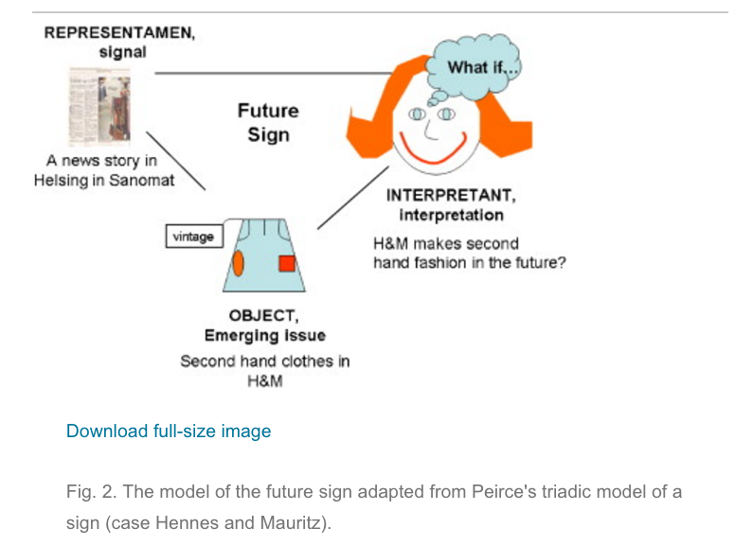
Notes:
From Hiltunen (2008) http://www.sciencedirect.com/science/article/pii/S0016328707001085#bib70
“The future sign is designed to function as a general model that can be used to understand the concept weak sign(al) and to estimate its characteristics. The future sign can be divided into three dimensions according to Peirce's sign: the object, the representamen and the interpretant. In the case of future signs, these dimensions have the following meanings:
The object refers to an (emerging) issue.
The representamen is the concrete form the sign takes. I will call this signal, because it is usually sent by someone (note: not in every case, though). In the case of future signs, signals can take the form of a news article, a rumour, a photo, a story in TV news, an image, etc. The signal is in connection with the issue.
The interpretant is a sense made of the future potentiality of the sign. This means the clarity to an interpreter of the sign to make assumptions of future events based on the sign. Contexts are included in this dimension, because interpreters make their conclusions about the signs in their own context.

Slide 6
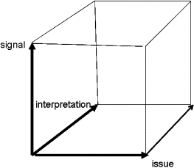
Notes:
What is the signal that you want to pick up from the three documentary previews you sawOLI page 29
What would Jesus buy? https://vimeo.com/63120451
True cost https://youtu.be/NDx711ibD1M
Minimalism https://vimeo.com/ondemand/minimalismfilm/153518223
Definitions from Hiltunen (2008)
The signal: the number and/or visibility of signals.
The issue: for example, the number of events. A variety of other units that describe the diffusion of the phenomenon are also possible (e.g. the percentage of net sales or the percentage of internal sales, the amount of employees abroad).
The interpretation: the receiver's understanding of the future sign's meaning (an organizational point of view of this can be the importance of the sign for an organization in the future).

Slide 7
Step 1. State the signal
Notes:
(3 minutes) What is the signal that you want to pick up from the three documentary previews you saw OLI page 29?
What would Jesus buy? https://vimeo.com/63120451
True cost https://youtu.be/NDx711ibD1M
Minimalism https://vimeo.com/ondemand/minimalismfilm/153518223
Definitions from Hiltunen (2008)
The signal: the number and/or visibility of signals.
The issue: for example, the number of events. A variety of other units that describe the diffusion of the phenomenon are also possible (e.g. the percentage of net sales or the percentage of internal sales, the amount of employees abroad).
The interpretation: the receiver's understanding of the future sign's meaning (an organizational point of view of this can be the importance of the sign for an organization in the future).

Slide 8
Step 2. State the issue
Notes:
What do you think the issue is in the future signal?
Definitions from Hiltunen (2008)
The signal: the number and/or visibility of signals.
The issue: for example, the number of events. A variety of other units that describe the diffusion of the phenomenon are also possible (e.g. the percentage of net sales or the percentage of internal sales, the amount of employees abroad).
The interpretation: the receiver's understanding of the future sign's meaning (an organizational point of view of this can be the importance of the sign for an organization in the future).

Slide 9
Step 3. What is your interpretation?
Notes:
What is your interpretation of the future sign?
What do you make of the signal and issue?
What might be features of design opportunities can you imagine based on the future sign?
For example, if consumerism is based on buying more and throwing it away faster.
What design features might “minimalism or true cost” have?
Definitions from Hiltunen (2008)
The signal: the number and/or visibility of signals.
The issue: for example, the number of events. A variety of other units that describe the diffusion of the phenomenon are also possible (e.g. the percentage of net sales or the percentage of internal sales, the amount of employees abroad).
The interpretation: the receiver's understanding of the future sign's meaning (an organizational point of view of this can be the importance of the sign for an organization in the future).

Slide 10
Step 4. What are some examples of products, environments, services, communications, etc that you might think to make in the future that align with your future sign?
Notes:
Imagine that the future sign that you’ve identified manifests itself as a strong reality in the future. What might be products that you could make that are aligned with such a future sign?

Slide 11

Stop Here. We will pick this up on Thursday.
Notes:
Image credit ::
By United Nations - Vienna Convention on Road Signs and Signals, Public Domain, https://commons.wikimedia.org/w/index.php?curid=2630010

Slide 12
Step 5. Going deeper into future signs (group)
What videos did your team members watch for homework?
Zero waste home lifestyle: Bea Johnson (add your name if you watched this)
Zero waste home lifestyle: Lauren Singer (add your name if you watched this)
Minimalist urban lifestyle: Joshua Fields Millburn (add your name if you watched this)
Minimalist urban lifestyle: Ryan Nicodemus (add your name if you watched this)
Minimalist urban lifestyle: Dave Bruno (add your name if you watched this)
Minimalist urban lifestyle: Liz Wright (add your name if you watched this)
Zero Waste Startup: Lauren Singer (add your name if you watched this)
Minimalist Fashion: Jennifer L. Scott (add your name if you watched this)
Digital Minimalism: Cal Newport (add your name if you watched this)
Delete Social Media Accounts: Jaron Lanier (add your name if you watched this)
Notes:
In the OLI homework page 20 You’ve just experienced some future signs around minimalism, post-consumerism, zero-waste lifestyles, and so forth. How do the videos you watched last night connect to your design opportunity?
How do the videos support or contradict your design opportunity from Step 4?

Slide 13
Step 6. Signal, Issue, and Interpretation
(individual step, write your name here team member 1)
What is the signal you’re addressing from the OLI page 20?
What is the issue?
What is your interpretation?
Notes:
For the video that each one of you watched in the OLI homework and conduct a future signal analysis like you did on Tuesday.
For example, imagine that the Bea Johnson and the Zero Waste household video is a future sign. What product opportunities might exist in a Zero Waste Lifestyle?
Or if you are an environments track student, what might the shopping environment (or a retail experience in a store) be in such a future?
If you are a communications design student what might be a communication product or strategy in such a world (e.g., print, posters, radio, social media, tv, etc)?
If you are an art student, what would people spend money on if it wasn’t consumerism? Might they be able to purchase art more broadly? How might the art market change if middle class people considered owning and collecting art?
Now critique 3 of your classmates projects.
What are the appropriate criteria for such a critique?
Who is the audience the designer imagined would be interested in such a product?
What are some of the forces of change that the product is aligned with?
Why is the product necessary in such a future?
How is the product made, what is the product lifecycle like?

Slide 14
Step 7. Describe the design opportunity and design concept (individual step, write your name here team member 1)
Notes:
For example, imagine that the Bea Johnson and the Zero Waste household video is a future sign. What product opportunities might exist in a Zero Waste Lifestyle?
Or if you are an environments track student, what might the shopping environment (or a retail experience in a store) be in such a future?
If you are a communications design student what might be a communication product or strategy in such a world (e.g., print, posters, radio, social media, tv, etc)?
If you are an art student, what would people spend money on if it wasn’t consumerism? Might they be able to purchase art more broadly? How might the art market change if middle class people considered owning and collecting art?

Slide 15
Step 8. Critique your projects with a team member (write your name here team member 1, Critic write your name here team member 2)
Notes:
Now critique your project or design opportunity, you can do this as pairs.
Who is the audience the designer imagined would be interested in such a product?
What are some of the forces of change that the product is aligned with?
Why is the product necessary in such a future?
How is the product made, what is the product lifecycle like?

Slide 16
Step 6. Signal, Issue, and Interpretation
(individual step, write your name here team member 2)
What is the signal you’re addressing from the OLI page 20?
What is the issue?
What is your interpretation?
Notes:
For the video that each one of you watched in the OLI homework and conduct a future signal analysis like you did on Tuesday.
For example, imagine that the Bea Johnson and the Zero Waste household video is a future sign. What product opportunities might exist in a Zero Waste Lifestyle?
Or if you are an environments track student, what might the shopping environment (or a retail experience in a store) be in such a future?
If you are a communications design student what might be a communication product or strategy in such a world (e.g., print, posters, radio, social media, tv, etc)?
If you are an art student, what would people spend money on if it wasn’t consumerism? Might they be able to purchase art more broadly? How might the art market change if middle class people considered owning and collecting art?
Now critique 3 of your classmates projects.
What are the appropriate criteria for such a critique?
Who is the audience the designer imagined would be interested in such a product?
What are some of the forces of change that the product is aligned with?
Why is the product necessary in such a future?
How is the product made, what is the product lifecycle like?

Slide 17
Step 7. Describe the design opportunity and design concept (individual step, write your name here team member 2)
Notes:
For example, imagine that the Bea Johnson and the Zero Waste household video is a future sign. What product opportunities might exist in a Zero Waste Lifestyle?
Or if you are an environments track student, what might the shopping environment (or a retail experience in a store) be in such a future?
If you are a communications design student what might be a communication product or strategy in such a world (e.g., print, posters, radio, social media, tv, etc)?
If you are an art student, what would people spend money on if it wasn’t consumerism? Might they be able to purchase art more broadly? How might the art market change if middle class people considered owning and collecting art?

Slide 18
Step 8. Critique your projects with a team member (write your name here team member 2, Critic write your name here team member 1)
Notes:
Now critique your project or design opportunity, you can do this as pairs.
Who is the audience the designer imagined would be interested in such a product?
What are some of the forces of change that the product is aligned with?
Why is the product necessary in such a future?
How is the product made, what is the product lifecycle like?

Slide 19
Step 6. Signal, Issue, and Interpretation
(individual step, write your name here team member 3)
What is the signal you’re addressing from the OLI page 20?
What is the issue?
What is your interpretation?
Notes:
For the video that each one of you watched in the OLI homework and conduct a future signal analysis like you did on Tuesday.
For example, imagine that the Bea Johnson and the Zero Waste household video is a future sign. What product opportunities might exist in a Zero Waste Lifestyle?
Or if you are an environments track student, what might the shopping environment (or a retail experience in a store) be in such a future?
If you are a communications design student what might be a communication product or strategy in such a world (e.g., print, posters, radio, social media, tv, etc)?
If you are an art student, what would people spend money on if it wasn’t consumerism? Might they be able to purchase art more broadly? How might the art market change if middle class people considered owning and collecting art?
Now critique 3 of your classmates projects.
What are the appropriate criteria for such a critique?
Who is the audience the designer imagined would be interested in such a product?
What are some of the forces of change that the product is aligned with?
Why is the product necessary in such a future?
How is the product made, what is the product lifecycle like?

Slide 20
Step 7. Describe the design opportunity and design concept (individual step, write your name here team member 3)
Notes:
For example, imagine that the Bea Johnson and the Zero Waste household video is a future sign. What product opportunities might exist in a Zero Waste Lifestyle?
Or if you are an environments track student, what might the shopping environment (or a retail experience in a store) be in such a future?
If you are a communications design student what might be a communication product or strategy in such a world (e.g., print, posters, radio, social media, tv, etc)?
If you are an art student, what would people spend money on if it wasn’t consumerism? Might they be able to purchase art more broadly? How might the art market change if middle class people considered owning and collecting art?

Slide 21
Step 8. Critique your projects with a team member (write your name here team member 3, Critic write your name here team member 4)
Notes:
Now critique your project or design opportunity, you can do this as pairs.
Who is the audience the designer imagined would be interested in such a product?
What are some of the forces of change that the product is aligned with?
Why is the product necessary in such a future?
How is the product made, what is the product lifecycle like?

Slide 22
Step 6. Signal, Issue, and Interpretation
(individual step, write your name here team member 4)
What is the signal you’re addressing from the OLI page 20?
What is the issue?
What is your interpretation?
Notes:
For the video that each one of you watched in the OLI homework and conduct a future signal analysis like you did on Tuesday.
For example, imagine that the Bea Johnson and the Zero Waste household video is a future sign. What product opportunities might exist in a Zero Waste Lifestyle?
Or if you are an environments track student, what might the shopping environment (or a retail experience in a store) be in such a future?
If you are a communications design student what might be a communication product or strategy in such a world (e.g., print, posters, radio, social media, tv, etc)?
If you are an art student, what would people spend money on if it wasn’t consumerism? Might they be able to purchase art more broadly? How might the art market change if middle class people considered owning and collecting art?
Now critique 3 of your classmates projects.
What are the appropriate criteria for such a critique?
Who is the audience the designer imagined would be interested in such a product?
What are some of the forces of change that the product is aligned with?
Why is the product necessary in such a future?
How is the product made, what is the product lifecycle like?

Slide 23
Step 7. Describe the design opportunity and design concept (individual step, write your name here team member 4)
Notes:
For example, imagine that the Bea Johnson and the Zero Waste household video is a future sign. What product opportunities might exist in a Zero Waste Lifestyle?
Or if you are an environments track student, what might the shopping environment (or a retail experience in a store) be in such a future?
If you are a communications design student what might be a communication product or strategy in such a world (e.g., print, posters, radio, social media, tv, etc)?
If you are an art student, what would people spend money on if it wasn’t consumerism? Might they be able to purchase art more broadly? How might the art market change if middle class people considered owning and collecting art?

Slide 24
Step 8. Critique your projects with a team member (write your name here team member 4, Critic write your name here team member 3)
Notes:
Now critique your project or design opportunity, you can do this as pairs.
Who is the audience the designer imagined would be interested in such a product?
What are some of the forces of change that the product is aligned with?
Why is the product necessary in such a future?
How is the product made, what is the product lifecycle like?

